Slide 1

Living
Better
With
Tinnitus:
Using Sound
Notes:
Progressive Tinnitus Management 2.0: Living Better with Tinnitus series includes 6 PowerPoints. This is the second PowerPoint of the series and focuses on using sound.
The recommended order is:
Introductory Session
Using Sound
Pleasant Activities
Relaxation
Communication Strategies and Planning for the Future
Balancing Thoughts and Feelings (Additional Session)
Materials that participants will need for this workshop:
Tinnitus Functional Index (TFI)
COSI for PTM 2.0
Sound Plan Worksheet
Optional Sound Exercise Worksheets
The Using Sound workshop is designed to guide Veterans to:
Identify how tinnitus impacts their lives, and the situations they want to focus on.
Learn how soothing, background and interesting sound can help them live better with tinnitus.
Create a sound plan for one area of focus.
The Living Better with Tinnitus workshop power point files are not meant to be given to the Veterans. They meet 508 compliance for use in a clinical setting for educational purposes with Veterans but are not meant to be provided as patient education handouts. They are a tool to share information, engage, and support the Veterans to live better with tinnitus.
When familiarizing yourself with the slides, it is highly recommended that you view the PowerPoint in presentation/slide show mode as there are many animated slides that appear to be redundant or missing if they are displayed in normal view (i.e., thumbnails present on left margin).
When you view the PowerPoint in presentation mode/slide show you are encouraged to use two monitors. If you are using two monitors when you present in presentation/slide show mode, you will be able to see the notes on one monitor while presenting the slides on the other monitor.
Most slides have additional information under notes. To view slide notes, select “ View” and then select ”Notes”.
Tips: If service connection comes up, feel free to encourage Veterans to get help from a Veteran Service Organization (VSO).

Slide 2

Safety for Virtual and Telephone Visits
Are you in a private, safe location?
You cannot be driving. If you are driving, please pullover over or reschedule.
Is the phone number in your VA medical record current?
Are you at the address listed in VA medical record? If not, please let us know where you are in case of emergency.
In case of an emergency, do I have your verbal consent to contact emergency contact/services?
Notes:
When holding a VVC or telephone session, remember safety is a top priority.
This slide should only be used for VA Video Connect (VVC) and telephone visits.
Check with your local Connected Care Coordinator and the VA Office of Connected Care website for current guidance.

Slide 3
Virtual Etiquette
Please wear appropriate attire
Please use respectful language
Please put your cell phone on mute, or on do not disturb
Mute your microphone if there’s background noise around you
Use the chat box if your microphone doesn’t work or if there is background noise
Due to privacy laws, don’t take any photographs or record any video or audio
Please refrain from using tobacco, alcohol or illicit substances during the session
If you need a bathroom break, please do not take your device with you
Notes:
You may find it helpful to remind everyone to practice virtual etiquette to keep the session on schedule and avoid any disruption.

Slide 4




Toolbar commands
Toolbar: Move your mouse or tap your screen to see it
VOLUME
UP/DOWN
CAMERA
ON/OFF
MIC
ON/OFF
DISCONNECT
Notes:
Discuss toolbar use at the onset of a VVC session.

Slide 5
Toolbar:
SPEAKER MUTE/
UNMUTE
CAMERA
ON/OFF
MIC
ON/OFF
DISCONNECT

Slide 6
Toolbar:1
CAMERA
ON/OFF
VOLUME
UP/DOWN
MIC
ON/OFF
DISCONNECT

Slide 7
Toolbar:2
MIC
ON/OFF
VOLUME
UP/DOWN
CAMERA
ON/OFF
DISCONNECT

Slide 8
Toolbar:3
DISCONNECT
VOLUME
UP/DOWN
CAMERA
ON/OFF
MIC
ON/OFF

Slide 9


Chat window upper left
CHAT
Event Box Icon -
Top left of screen

Slide 10

Please Silence Your Mobile Devices
Notes:
Ask Veterans to silence their mobile devices before the session begins. This will help eliminate any distractions and prevent those connecting via mobile device from getting disconnected.

Slide 11

Veterans Crisis Line
Notes:
Please advise the Veterans the contact information for the Crisis Line was updated on a national basis and access was simplified.
Remind participants that if they are in a crisis at any time, qualified caring VA professionals are ready to help them.
If you or anyone you know is in crisis: call, click or text 24 hours a day, 7 days a week, 365 days a year. It is free and confidential.
Remind participants that in case of an emergency, they should contact 911 or go to the nearest emergency room.

Slide 12
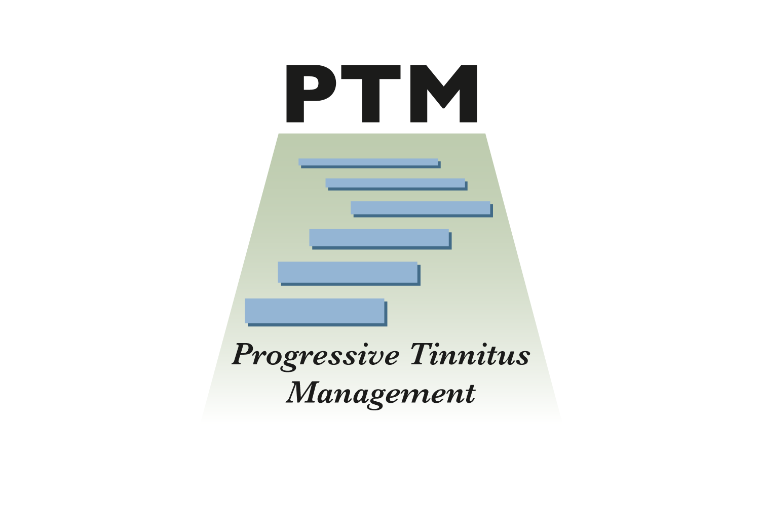
PTM
These materials have been adapted from the Progressive Tinnitus Management program originally developed by researchers at the National Center for Rehabilitative Auditory Research (NCRAR) and updated in collaboration with VHA OPCC&CT (Whole Health), Audiology, and Mental/Behavioral Health.

Slide 13

Introduction
Share your name and
what you hope to get out of today’s session.
Notes:
Take the time to introduce yourself and have the participants introduce themselves.
Ask each veteran to state what they hope to get from the workshop.
Remember to keep the expectations realistic and obtainable.

Slide 14
Today We Will:
Brainstorm ways to use sound to improve a situation you choose to work on
Leave with a plan for the sounds you will try
Notes:
Discuss slide content.

Slide 15
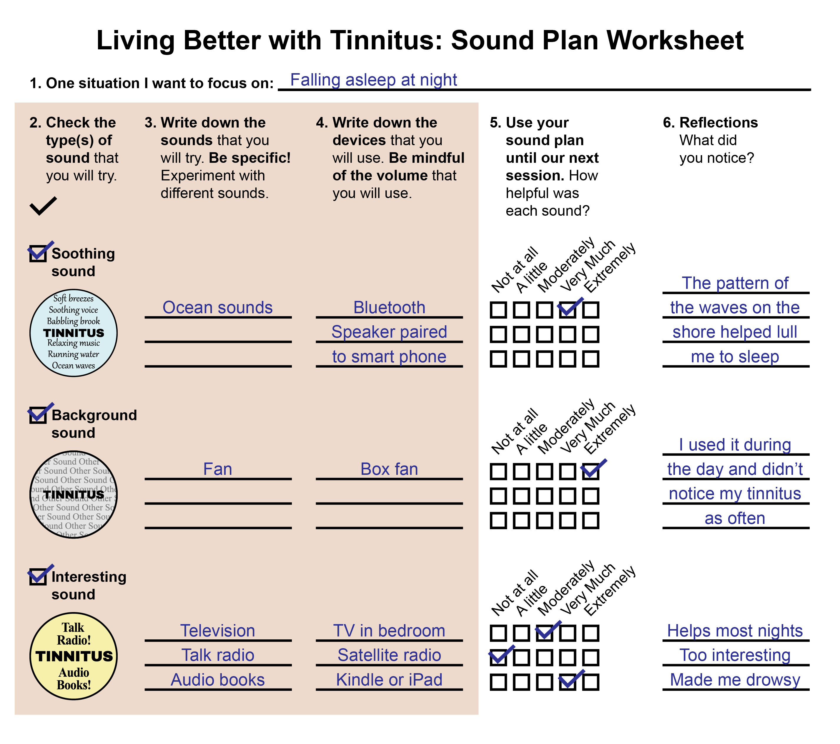
Today We Will:1
Brainstorm ways to use sound to improve a situation you choose to work on
Leave with a plan for the sounds you will try
Notes:
Discuss slide content.

Slide 16
My Role
    Provide you with structure and information as you fill out your sound plan
    Let you come up with the ideas for the sounds you will try
      However, sometimes I might ask for permission to give you an idea
Notes:
Discuss your role as the provider which is to share information, brainstorm ideas for using sound with the participants, and provide guidance and support.
Notes for the provider:
We want providers to ask permission before offering an idea or advice. “I’m here to share information, brainstorm ideas with you, provide guidance and support, and help you explore what works for you. It’s all trial and error. Each person is different. Keep an open mind”.
Elicit, provide, elicit - ask what have they tried, let them tell you. Remember that information does not necessarily lead into action. Your interaction with the Veterans, your support and guidance is what helps them get into action.
For a lot of Veterans, it won’t feel good to have a clinician leap in with the answers—the Veteran has probably tried a bunch of things—if you leap in with answers without understanding what they’ve done, it may not land well and won’t be good for the relationship between Veteran and provider. The relationship is where the magic is.
This interaction paradigm is aligned with what Whole Health is trying to accomplish—aiming for a paradigm shift for clinicians helping them shift away from “find a problem and fix it”, to instead focusing first on what matters most to the patient, and letting the patients lead the way to find solutions that work for them. The clinician's job is to provide carefully-managed guidance and support.
We don’t want to just focus on the ear, we want to take the entire person into consideration and allow participants to lead the way as much as possible. This interaction will naturally help bring the whole person into the process of improving quality of life with tinnitus.

Slide 17
Your Role
Be open to trying sound in unusual or unexpected ways
Follow your hunches, or your intuition about which sounds you think will help you the most and to add those sounds to your plan
Use the sounds you add to your plan between today and the next session
At the next session, you’ll talk about how it went using sound
Notes:
Discuss the patient’s role which is to follow their intuition about which sounds they think may help and try at least one before they come back
If someone comes back and they have not tried anything, just acknowledge that you are glad that they came back and encourage them to use at least one sound until they return.

Slide 18
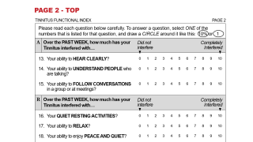
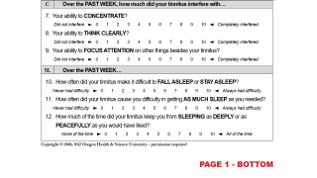
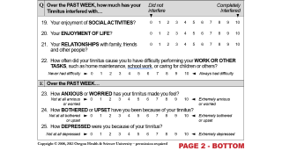
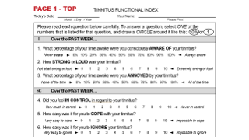
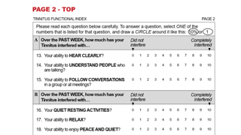


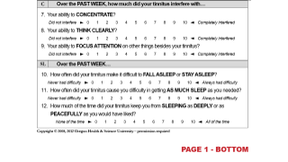
Please Complete the Tinnitus Functional Index
Write your name on it
Don’t overthink your answers
There are 2 sides to the form
It helps assess your progress
on living better with tinnitus
Notes:
If the visit is in-person, consider the amount of time allotted for completion of the TFI. Veterans who need additional time can be offered the option of staying after the session, returning it via mail or via my HealtheVet secure messaging.
If the visit is via telehealth (i.e. VVC), consider mailing the TFI to the Veteran prior to class with a return envelope to mail it back or you can send it to the Veteran via My HealtheVet, and the Veteran can return the TFI as an attachment via my HealtheVet secure messaging.
Outcomes:
PTM may be implemented differently based on local resources and needs; therefore, it is strongly recommended to track outcomes using a statistically validated instrument like the Tinnitus Functional Index (TFI).
The TFI is a measure used to assess the subjective impact of tinnitus. It is a 25-item measure with eight-subscales.
Copies can be found at the National Center for Rehabilitative Auditory Research (NCRAR) website.
The TFI score collected for this session will be the baseline measurement for each Veteran. TFI baseline score doesn’t predict success in the program, and it is not an indicator of appropriateness to participate in the program.
TFI should also be administered after the completion of the program to track progress. To assess the outcomes of your program, you will calculate a change score for each participant and then find the mean change score for the group. After you have change scores for all participants, you can use that mean change score for quality assurance and quality improvement purposes. You may compare the mean change on the TFI for your population to published data, to your peers, and to yourself over time. If you need to improve your outcomes, consider following the suggested progressive tinnitus management/living better with tinnitus guidelines closely.
The best use of the TFI is quality assurance for a group of people, although it can be used for an individual. For individuals, there may be mismatches between TFI outcomes and subjective reports of change (the COSI for PTM 2.0 discussed later may be used for this). In cases where the participant is saying on the COSI for PTM 2.0 that they are doing better, but on the TFI they appear to be doing worse (or vice versa), carefully explore the mismatch to assist in determining the need for further care and to explore additional patient-centered needs. Don’t make changes to how they filled out the TFI, just explore the responses to be sure that you and the participant have a shared understanding of how they are doing.
It is important to ask individual patients to give you their self-assessment of quality-of-life improvement. The COSI for PTM 2.0 may be used for that purpose. Asking for a subjective impression of improvement will help to ensure you are not assigning meaning to a TFI outcome that an individual is not experiencing.
The TMS Module Progressive Tinnitus Management 2.0: Living Better With Tinnitus – Communication Strategies and Planning for the Future has more information about how to use the TFI to measure outcomes.
The TFI is excellent to use for quality control purposes; however, for practical reasons, some sites choose not to implement the use of the TFI. A modified version of the Client Oriented Scale of Improvement (COSI) was developed for use with PTM 2.0, and it is embedded into the workshop series. The COSI for PTM 2.0 is not statistically validated, but it does provide important information about the patient’s perception of individual progress as a result of participating in the program.

Slide 19
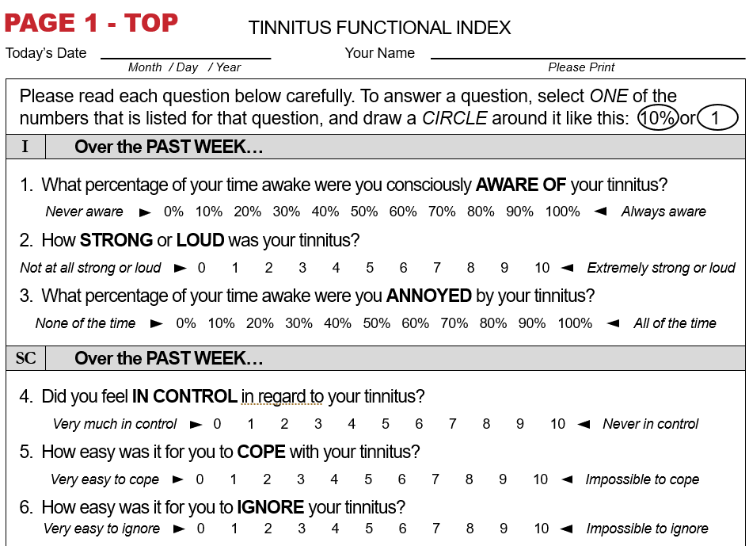
Tinnitus Functional Index Page 1 Top

Slide 20
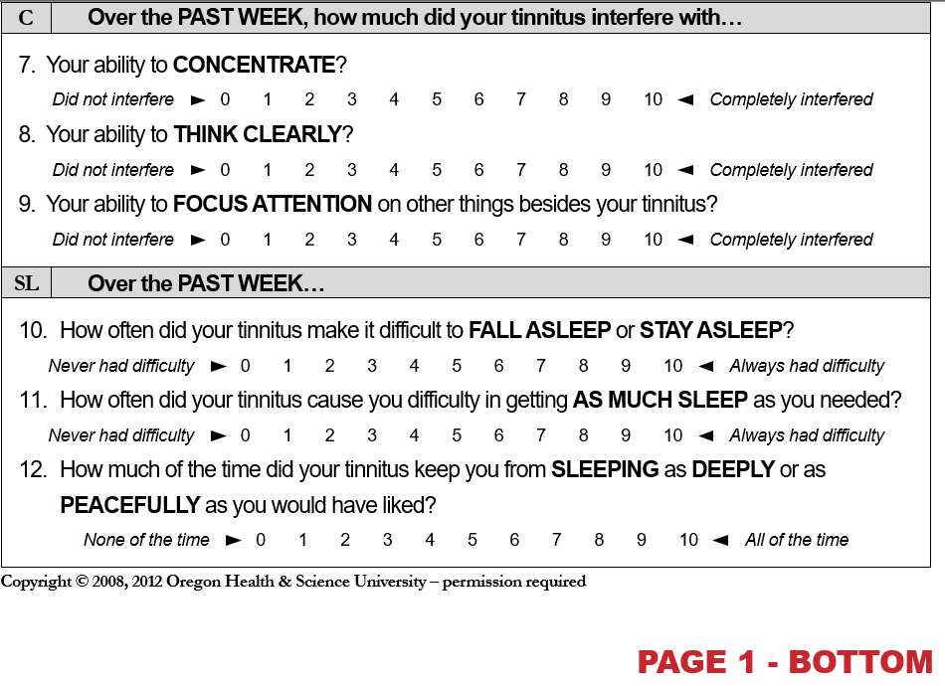
Page 1 bottom

Slide 21
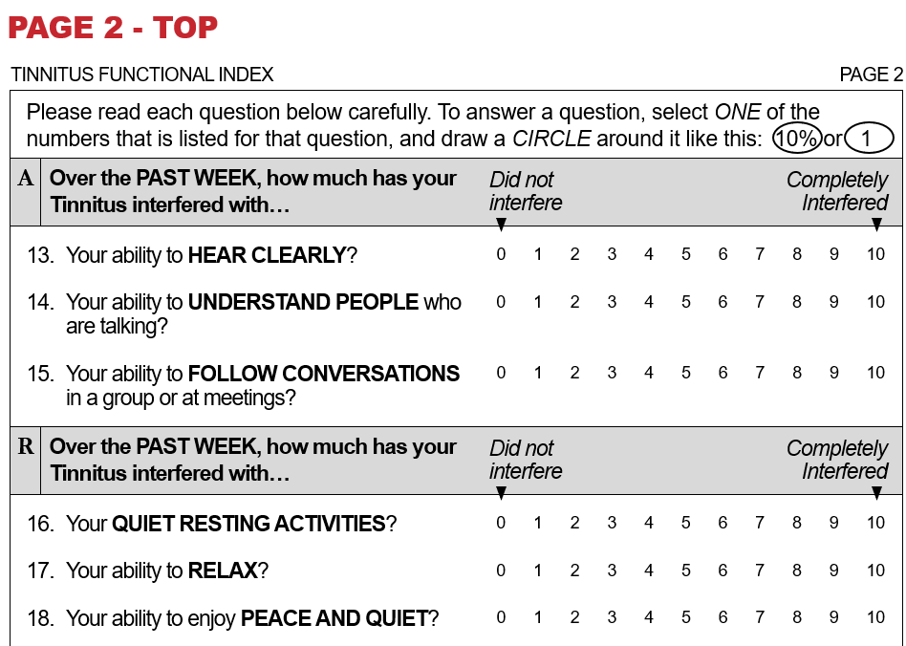
Page 2 top

Slide 22
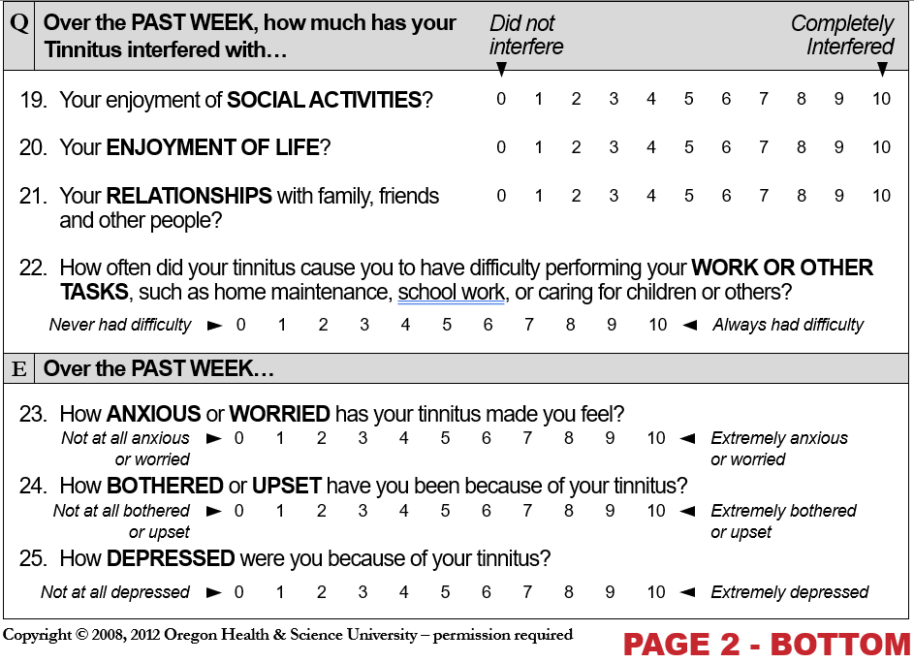
Page 2 bottom

Slide 23
Using Sound
You can use sound to:
    Feel more comfortable when your tinnitus is bothering you
    Help you do what you want to do even with tinnitus
Explore and experiment!
Notes:
The purpose of using sound is to help the participant(s) do what they want to do even with tinnitus.
Instructions for the session:
Sometimes people think sound “doesn’t work” for them because they can’t cover up or quiet their tinnitus comfortably. The purpose is to live more comfortably with tinnitus.

Slide 24
We WILL NOT Focus on Quieting Tinnitus
Unfortunately, no one knows how to quiet tinnitus
Searching for ways to quiet tinnitus makes some people
feel worse and frustrated
Notes:
The purpose of using sound is not to cover or quiet tinnitus.
Searching for ways to “quiet or cover” tinnitus makes some people feel worse and frustrated.

Slide 25
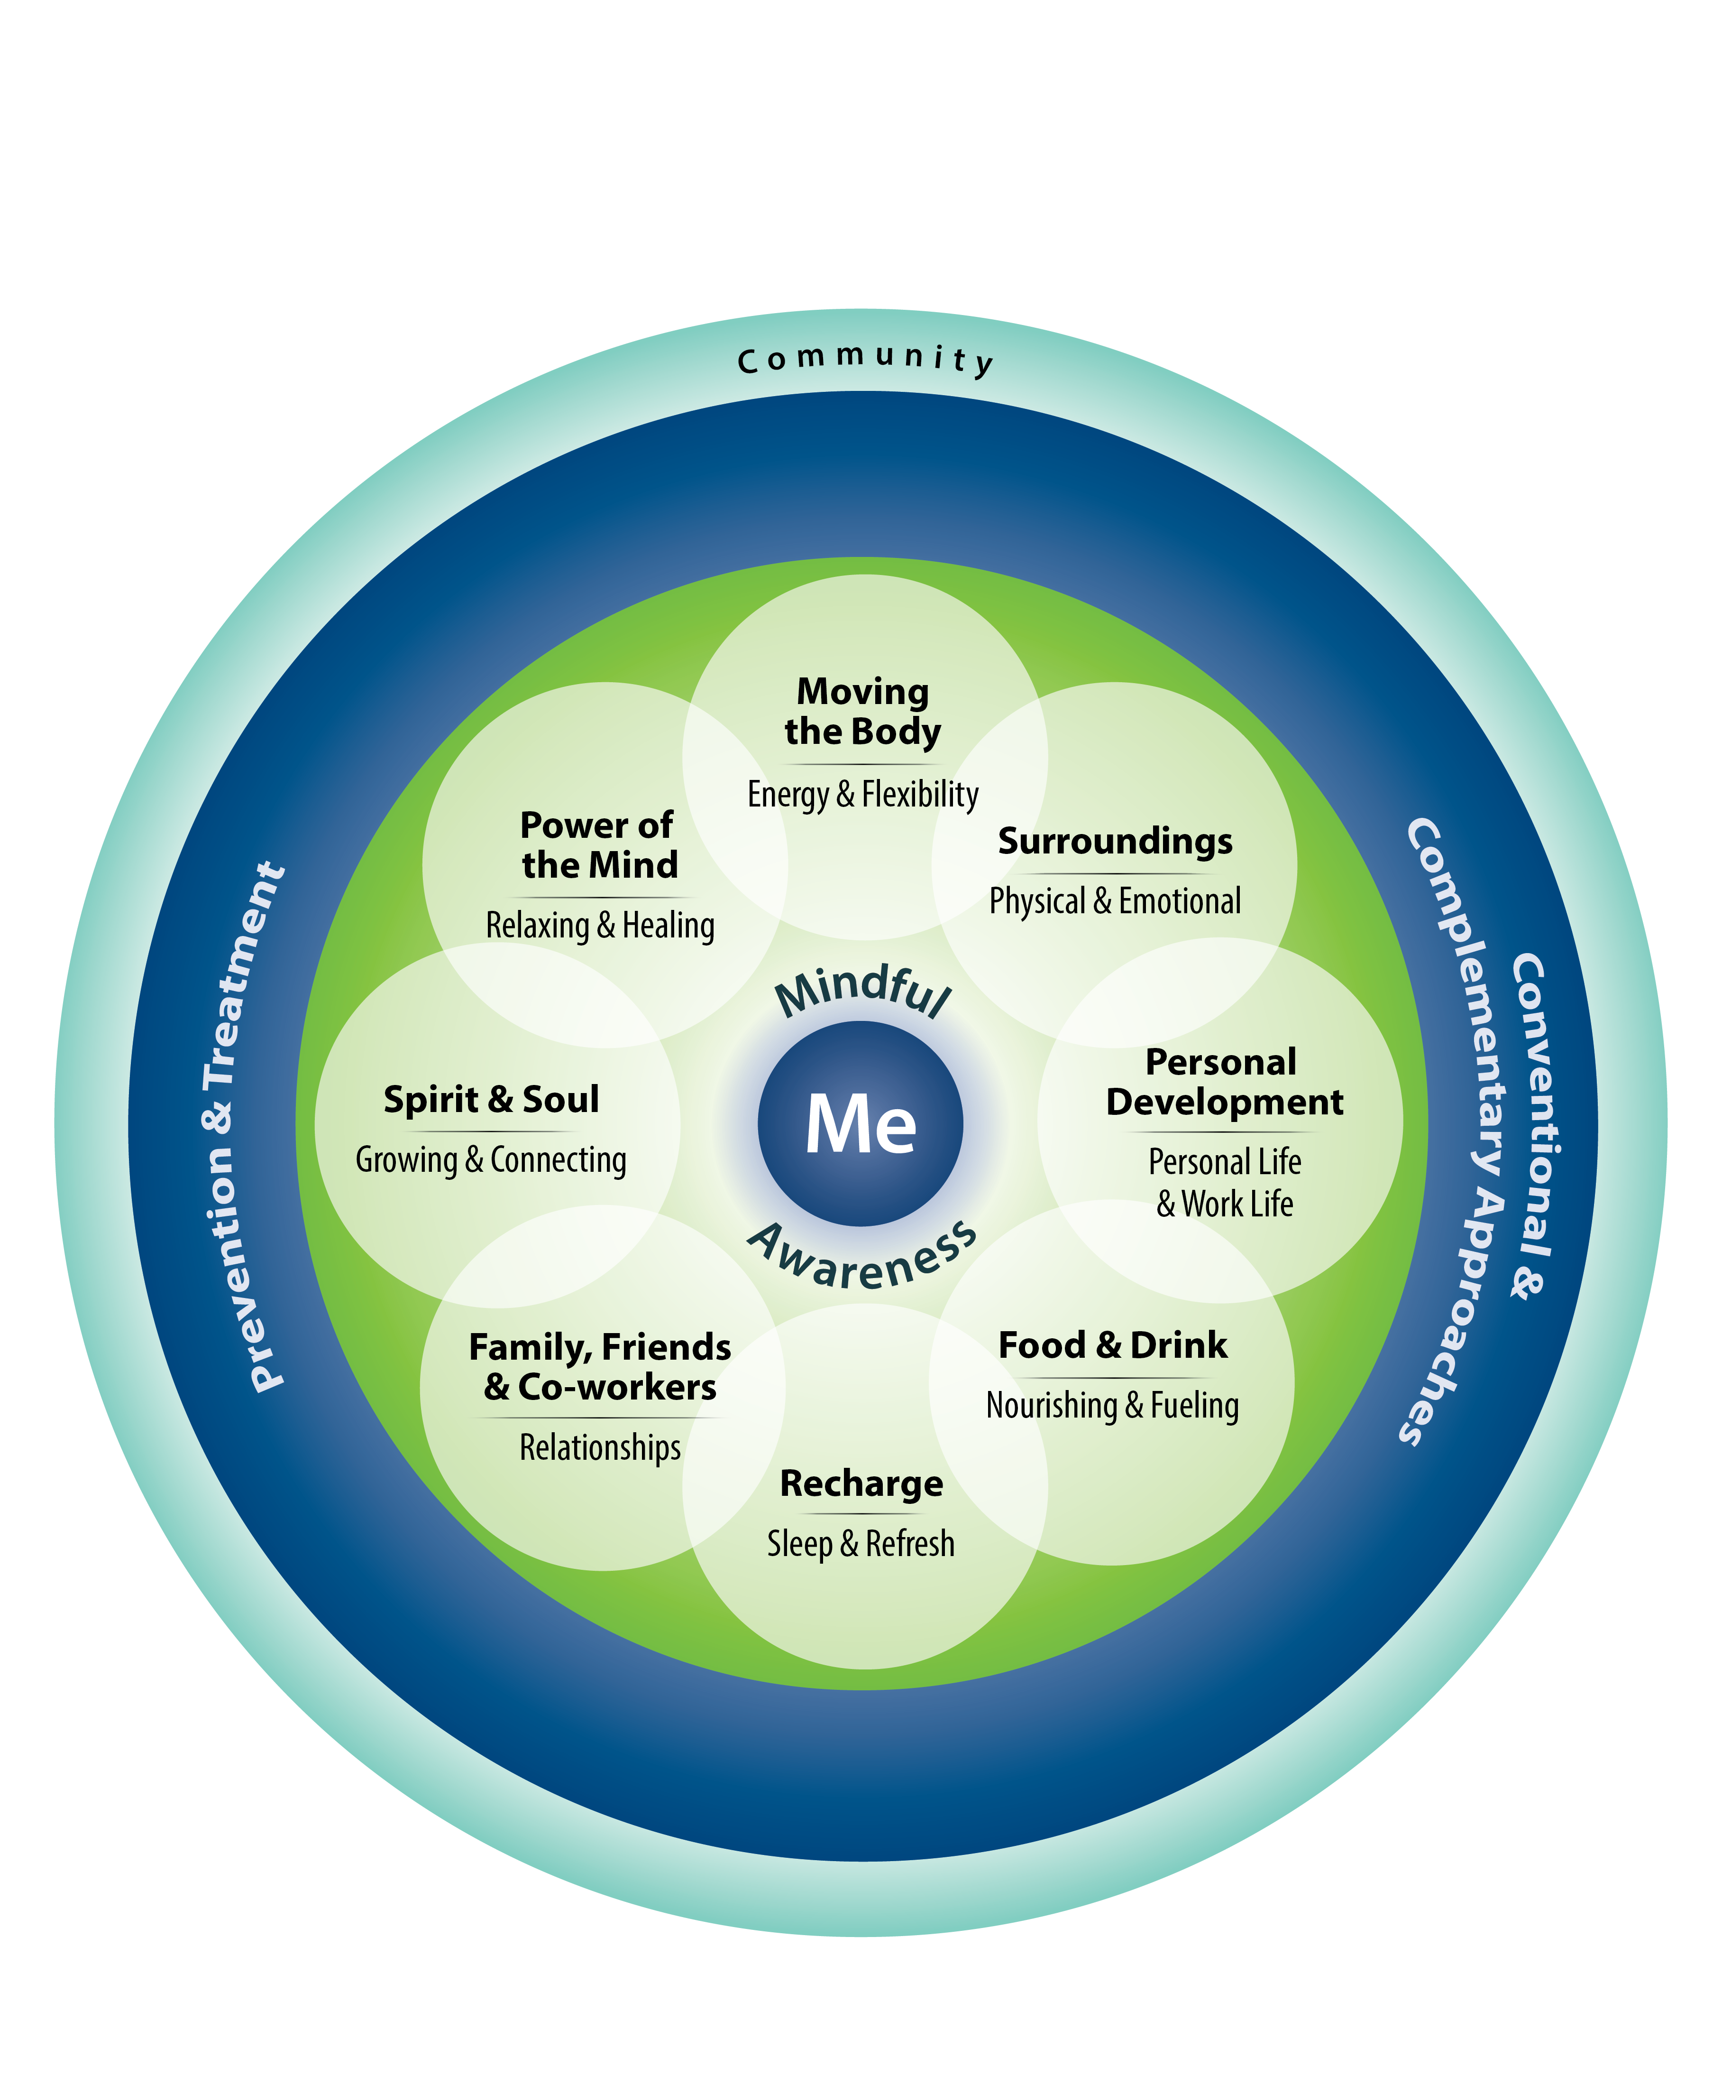
We WILL Focus on Living Better with Tinnitus
We can’t cure tinnitus, but…
We can learn to live better with tinnitus
What Does Living Better
with Tinnitus Mean?
Notes:
Briefly discuss the Circle of Health. Emphasize that we can’t cure tinnitus, but there are things the participant can do to live better with tinnitus.
In the circle, the center is me (the person with tinnitus), mindful awareness, self-care, professional care and community involvement.
Instructions for the session:
Briefly review with Veterans the Circle of Health. Additional information can be found at the Whole Health website.
Whole Health focuses on the person who has tinnitus not on the diagnosis of tinnitus.
Instead of focusing on the symptoms and conditions, the whole health approach to care empowers people to establish wellness priorities so they can live their whole life better even with tinnitus.
Whole health focuses on what matters to each person in their life. It offers support and guidance for them to take simple actions and develop healthier daily life habits for better health and well-being.
Introductory information about the Circle of Health was discussed in the Living Better with Tinnitus: Introductory session. Refer to that PowerPoint if a review of whole health information is needed.

Slide 26
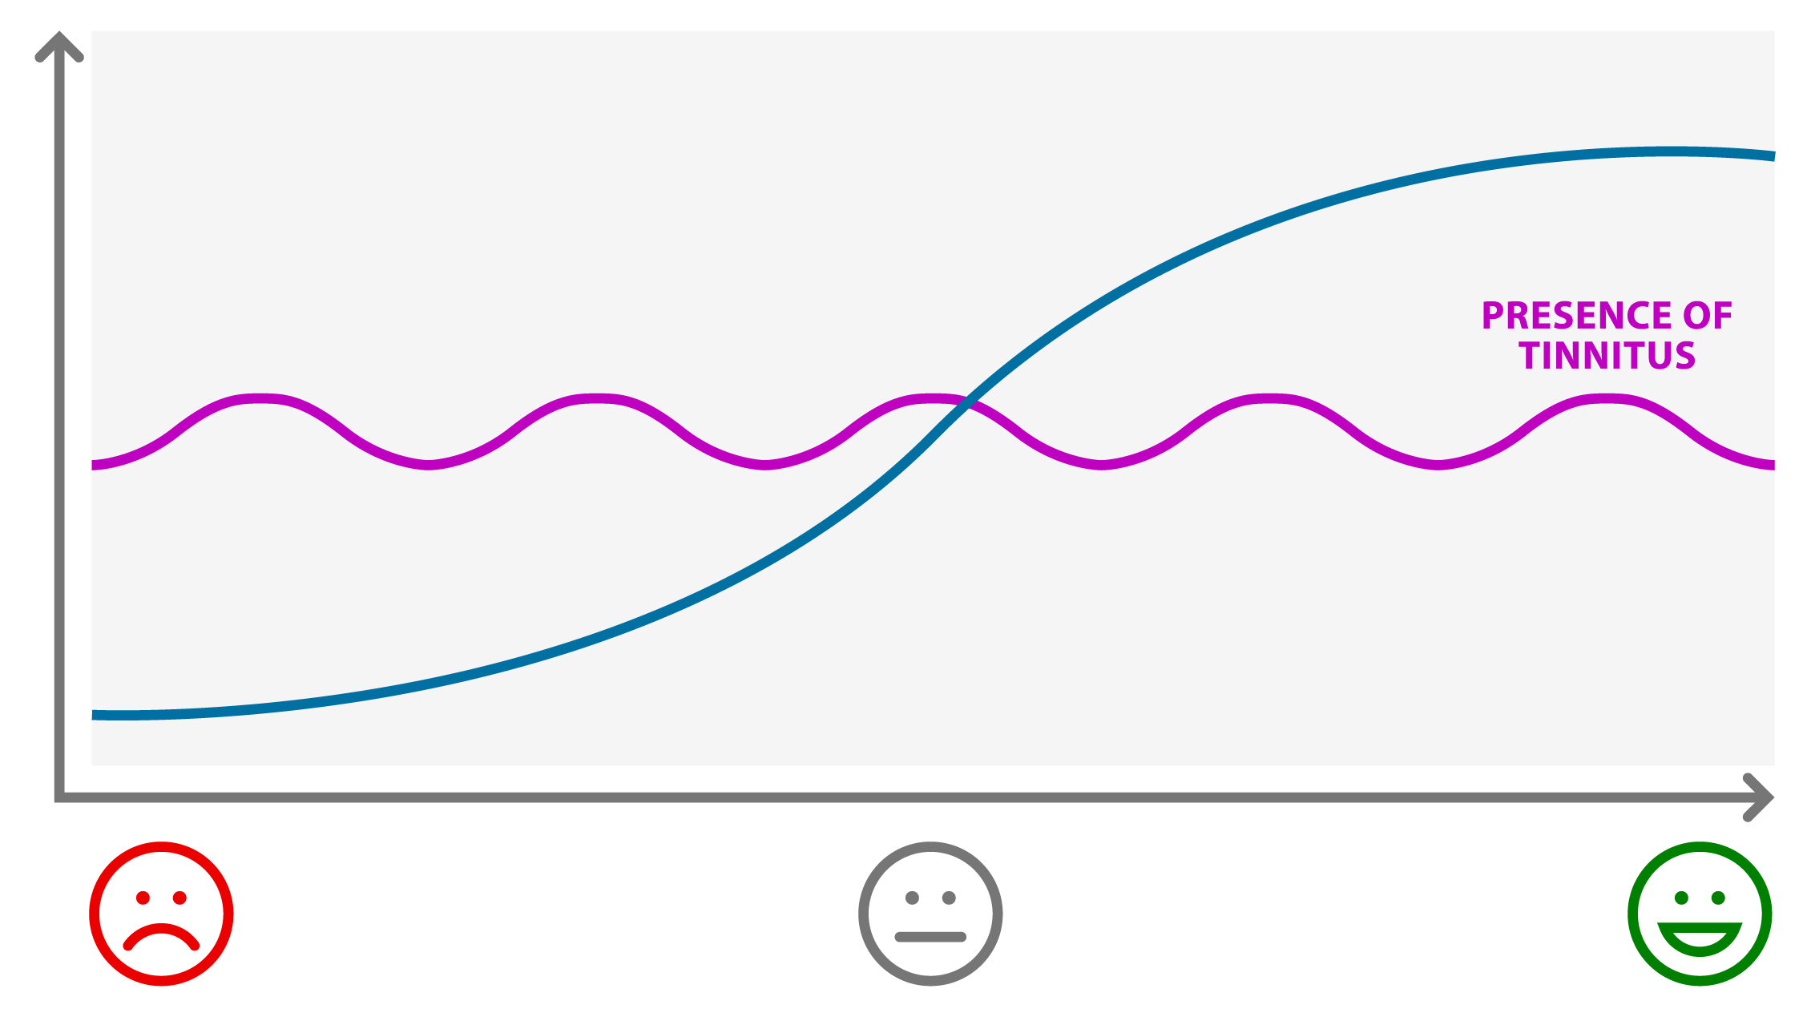
Living Better with Tinnitus: Example
Sleeping better with tinnitus
Practicing coping strategies
Today we’ll focus on using sound as a coping strategy
Tinnitus interfering
with sleep
Notes:
In this example, tinnitus is interfering with sleep.
As the person begins to practice using sound as a coping strategy, sleep begins to improve even though tinnitus has not changed.
As the person experiments with using sound over time, the person learns which sounds are most helpful, and sleep and quality of life improve over time.

Slide 27
The Meaning of Living Better Could Vary
Living Better Could Mean:
Sleeping better
More relaxed
Less stressed
Less irritable
Easier to focus
Improved Relationships
Notes:
Living better could mean different things to different people.
Invite participants to think about what “living better with tinnitus” would mean for them.
You may ask the participants: Is there anything else here that you think should be added?
Instructions for the session:
The blue line is the process of learning and implementing coping skills consistently over time. This process takes simple steps and sustained actions.
Give some examples of what this might mean—sleeping better with tinnitus, feeling less anxious with tinnitus, relaxing with tinnitus, concentrating better with tinnitus, doing the things you want to do with tinnitus, improving your relationships, etc.
Ask: How does tinnitus affect your life? What would you like to be doing but aren’t doing because of tinnitus?

Slide 28
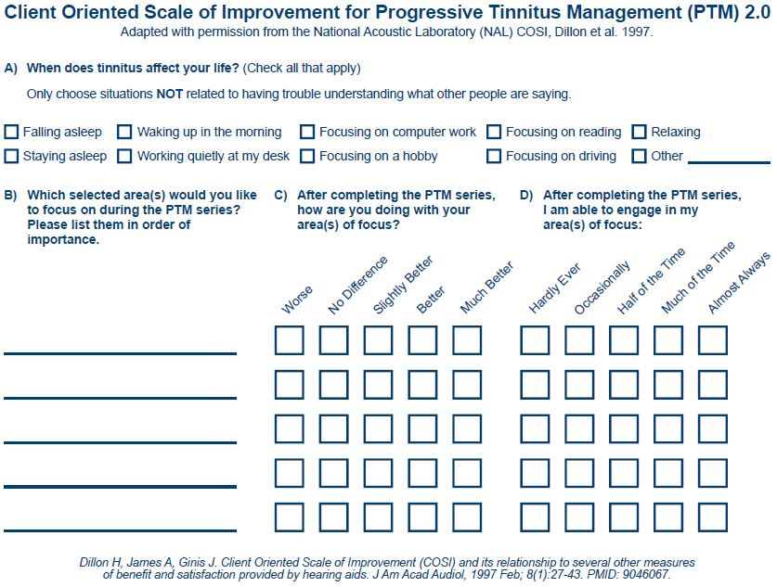
Client oriented scale of improvement
Notes:
Ensure the participants have the COSI for PTM 2.0 and sound plan worksheet available. The COSI for PTM 2.0 has been adapted with permission from the original NAL COSI developed by Dillon et al (1997).
The COSI for PTM 2.0 can be used:
as a self-assessment of quality-of-life improvement;
to assess subjective change in the areas of focus that the participant chooses;
to explore additional patient-centered needs; and
to assist in determining the need for further care.
Ask the participants to answer the question “How does tinnitus affect your life?” and check all that apply on section A. Instruct the participants to write down on section B, in order of importance, the selected areas that they want to focus on during the PTM series. Advise the participants to complete Sections C and D at the end of the PTM series.
You may want to record participant’s responses when you document the session in the electronic health record. If you do this, numbering each item under section A might be helpful.
Instructions for the session:
Encourage participants to chose areas NOT related to having trouble understanding what other people are saying. The coping strategies that we will talk about in the workshop series will not help with trouble understanding what others are saying. For help with understanding what others are saying, encourage participants to talk to their audiologist.
Encourage participants to continue connecting their area(s) of focus in each subsequent session. For example, if they chose to focus on relaxing, encourage them to connect how the relaxation session can help.
At times people may report that they can do what they want to do, but they are very unhappy about hearing tinnitus. Be sure to talk about the purpose and realistic expectations of using sound.
Notes for the provider:
For sleep issues, encourage participants to use sound at night. Sound should help sleeping with tinnitus.
If sleep problems persists, there is probably a sleep issue which will require referral to primary care or other specialty. Get enough information to refer the patient back to their provider with any information that might be useful. Asking the following about their sleep may be helpful:
Do you wake up with enough energy to do the things that matter the most to you?
Do you have sleep issues that don’t have anything to do with tinnitus? (Restless leg, chronic pain, obstructive sleep apnea, PTSD, and nightmares).
Other conditions may also impact the area they selected. For example, having difficulty with focus may be impacted by hearing loss or PTSD or ADHD. Please check to see if the participant may need to be connected with another provider to be a part of their care team.

Slide 29
Group Discussion: Stop and Talk About it
Please share with the group one area that you want to focus on from COSI-PTM 2.0
Why is that important to you?
Is there anything other than tinnitus contributing to the problem within the area you chose?
  For example, many factors can contribute to sleep problems or trouble focusing
Notes:
Have participants share one area they would like to focus on.
If a participant lists a hearing problem as the most bothersome tinnitus situation, redirect the participant to choose a tinnitus problem instead.
Instructions for the session:
Stop here until everyone has talked about the area they would like to focus on over the next week.
Listen carefully to what each participant lists as their area(s) of focus.
Occasionally some participants will report some version of “I want to hear better” or “some sounds make my tinnitus louder” as their most bothersome situation. These participants are usually hoping to find a way to either hear better or prevent sounds from making their tinnitus worse. This cannot be accomplished through use of a sound plan. In these cases, you have a couple of options:
Screen for hearing issues; see Part B of the Tinnitus and Hearing Survey;
Screen for sound tolerance issues; see Part C of the Tinnitus and Hearing Survey;
Redirect the participant to choose an area when the tinnitus itself is a problem.

Slide 30
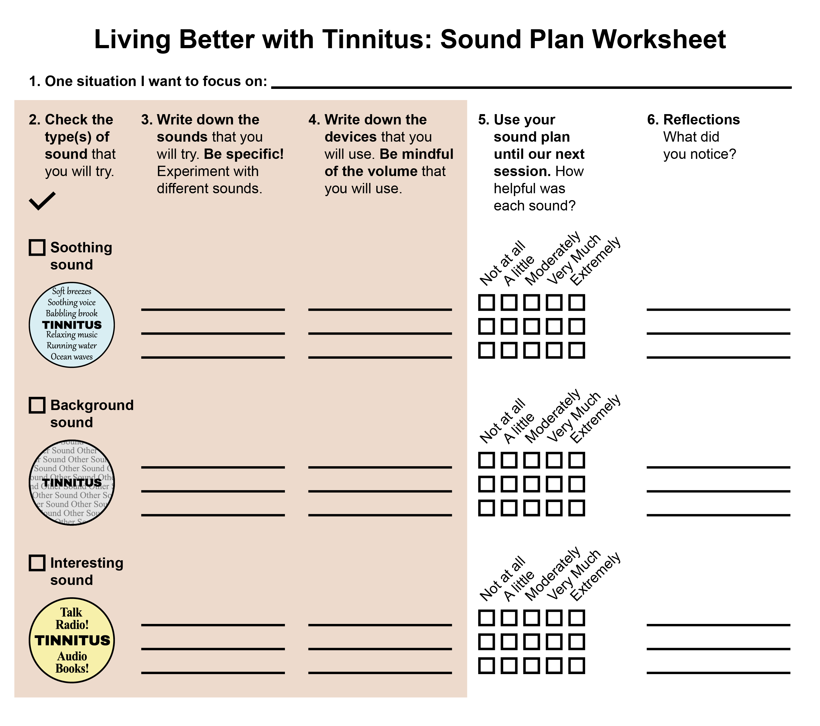
Sound Plan Worksheet
This is the form you will use to develop a plan to use sound to live better with tinnitus
Notes:
This is the form the participants will use to develop a plan to use sound to live better with tinnitus.
Instructions for the session:
Some may already have sounds that they like, “old faithful” sounds.
Some may have no experience using sound to live better with tinnitus.
Encourage discovery of a variety of sounds.
Encourage participants to keep an open mind; it is about experimenting with new or different sounds.
For those who don’t like any sound at all, follow up regarding sound tolerance issues.
Caution about volume: not trying to match, cover, or make tinnitus disappear.
Keep volume from low to comfortable, not loud.

Slide 31
Choose a Situation
Write down the situation you chose from your COSI-PTM 2.0
Notes:
At this point you will ask the participants to write the situation from the COSI-PTM 2.0 on their sound plan worksheet.

Slide 32

Three Types of Sound
Next, we’ll learn about
three types of sound:
Soothing Sound
Background Sound
Interesting Sound
Notes:
Introduce three type of sound to the participants
soothing sound to help the person feel more comfortable, calm and relaxed
background sound to enrich their environment with sound
interesting sound to shift their attention
As you discuss using sound, encourage participants to focus on how sound makes them feel or how sound will help them do what they want to do. Avoid focusing on the way sound impacts tinnitus.
Instructions for the session:
Remind participants to use a comfortable level of sound.
Ask: Is anyone already using sound? What kind? How are you using it?
Encourage participants to try different sounds. Also alert them that their choice of sound may vary depending on many factors: time of day, activity, how they feel, what are they trying to do- whether sleep or relax, work, concentrate, etc.
It is good to have a variety of sounds and create a contingency plan for when not at home, like when on vacation, driving, at work, at a hotel, when power goes out, etc.
Encourage participants to use sound they like. Listening to sounds that are enjoyable and meaningful can help.
Sometimes people think sound “doesn’t work” for them because they can’t cover up their tinnitus comfortably. The purpose of using sound is not to cover tinnitus or make it go away. The purpose is to live more comfortably with tinnitus. Searching for ways to “avoid, quiet or cancel out” tinnitus makes some people feel worse.
Using sound will not help with hearing problems.
Some Veterans may need to go at a slower pace (not ready to make a sound plan, sound tolerance problems that interfere with participation, etc.). In those cases, consider working with that Veteran one-on-one so that they can progress at their own speed.

Slide 33
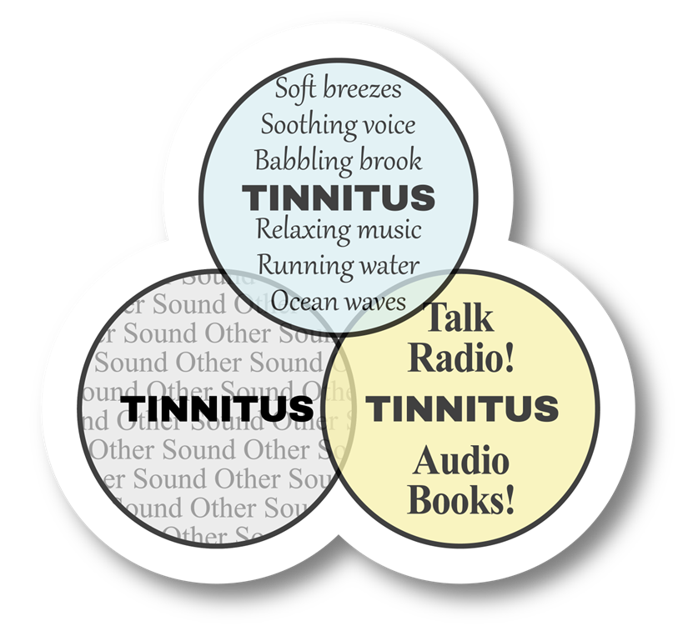
Types of Sound
Soothing Sound
Background Sound
Interesting Sound
Notes:
Discuss with the participants that different sounds can be used to live better with tinnitus.
Feel free to use this slide to discuss the overlap of the types of sound. The discussion can help solidify the concept for participants. A single sound might impact people in more than one way. For example, listening to music might be both interesting and soothing to the person listening.
The purpose of discussing types of sound is to:
Avoid the “masking” mindset and to guide participants towards realistic expectations for using sound.
Provide a framework for participants to generate their own ideas for sounds they would like to try.
Regardless of the type of sound, the purpose is to help the person improve quality of life with tinnitus.

Slide 34
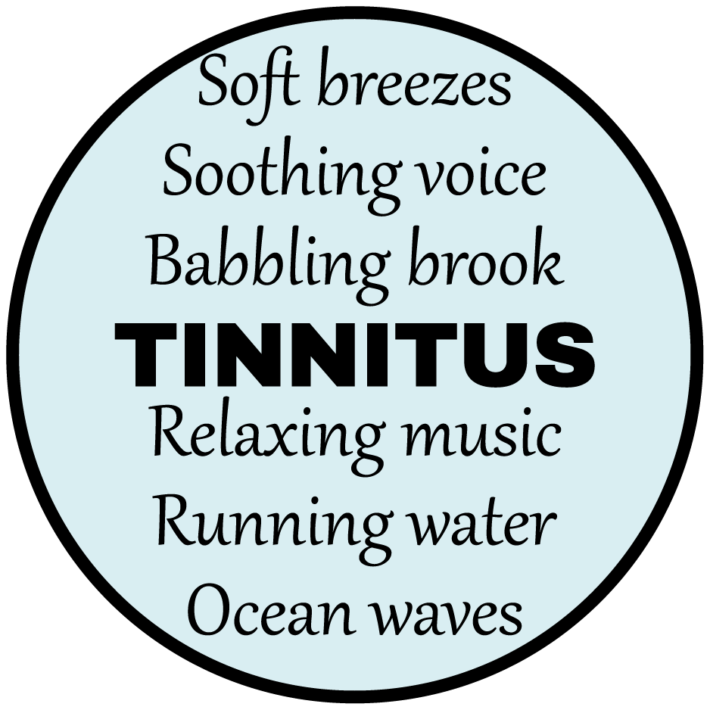
What is Soothing Sound?
Notes:
Orient the participant to the soothing sound section of the worksheet

Slide 35
Soothing Sound
What is it?
    Sound that makes you feel better when you hear it
  How can it help?
    By helping you feel more calm, relaxed, and comfortable
  When can it help?
    Anytime
Notes:
Use this slide to explain what soothing sound is and how and when can it help.

Slide 36
Soothing Sound: Examples
Environmental Sound
Music
Speech
Ocean waves
Wind chimes
Insect sounds
Any environmental
sound that is soothing to you
Classical music
New Age music
Relaxation music
Slow tempo music
Any music that is
soothing to you
Guided relaxation exercises (imagery, deep breathing, etc.)
Guided meditation exercises
Any speech that is
soothing to you
Any of these could be live or recorded.
Notes:
Walk participant through these examples of sounds that are soothing for a lot of people.
These are examples to get ideas flowing; your participants may use some or none of these.
Remind participants that soothing sound can be recorded or can be live in their environment.
Instructions for the session:
Sound can be from the environment, music or speech
Maybe prompt some who can’t think of a soothing sound to try to think of a sound that they associate with a relaxing memory.

Slide 37
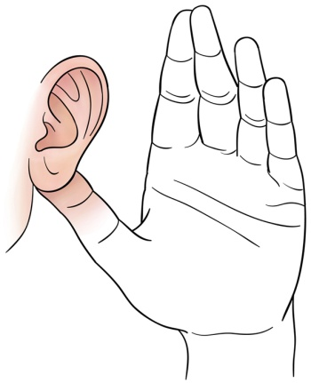

Soothing Sound Activity
Let’s try it!
Not
Soothing
Slightly
Soothing
Mildly
Soothing
Moderately
Soothing
Very
Soothing
Extremely
Soothing
Click
Here
(Be ready to share your rating with the group)
Notes:
Use the slide to give participants some experience with paying attention to whether a sound is soothing for them.
If unable to use a sound for this activity, ask participants to share ideas of sounds that are soothing to them.
Instructions for the session:
Encourage the participants to try more than one sound including sounds they may not have thought would be soothing. Keep an open mind.
Ask: “Which sounds do you think will make you feel calmer and relaxed?” And let them discuss.
If unable to use a sound for this activity, ask participants to share ideas of sounds that are soothing to them.
If they don’t have ideas, or if you can’t play a sound for them, then provide some examples.
Beware of volume: advise the participants to adjust the volume until they find the level that is most soothing to them (from low to comfortable level, but not loud).
Notes for the provider:
When people in a group react very differently to the same sound, acknowledge that some sounds may be more helpful than others. It is up to each person to find the sounds that are helpful to them. Point out that it takes time, trial and error.
Playing a sound for this activity, might not work as well for virtual groups. Provider might ask: Which sounds make you feel calm and relaxed?
Let group members share their experiences using soothing sounds if they are already successful with them. If they don’t have ideas, say: “Look at some examples in the handouts”.
Use your discretion when sharing sound. Some Veterans may not be able to hear it, or they aren’t wearing their hearing aids, etc.

Slide 38
Soothing Sound: Things to Think About
The sound you just heard is more soothing to some people, and less soothing to others
Your job is to find sounds that are soothing to you
It might take time and patience to find the sounds that are most soothing and helpful for you
Notes:
Use this slide to emphasize that soothing sound preferences will vary from person to person.
Instructions for the session:
If not demonstrating sounds, adjust the wording of the first bullet point
Explain that some sounds may be more soothing to some people and less soothing to others.
Provide an example: “Rain may be ok for some, but thunder can be alarming for others.”

Slide 39
Sound That is Soothing and Meaningful
Sound that is soothing and has meaning to you might be especially helpful.
Let’s discuss these options:
Using soothing sound to feel calmer and more relaxed is helpful for many
Adding soothing sound that you want in your life because it’s meaningful is another approach
Can you think of a sound that is both soothing and meaningful to you?
Notes:
Discuss with the participants that using soothing sound to feel calmer and more relaxed is helpful for many.
Another option is to focus on adding meaningful sound that they want in their life. For example, soothing sounds that reminds them of pleasant memories, relaxing music they enjoyed in the past, or soothing sound that is connected to their values.
Instructions for the session:
Sometimes people start out doing well with using soothing sound to feel more comfortable, but eventually it loses the effectiveness.
Encourage the participants to come up with more than one soothing sound to try.

Slide 40

Martha’s Story
Notes:
Note to the provider: This slide and the next slide work together as animated slides when in presentation mode. Please look at them in presentation mode before changing or deleting.

Slide 41
Martha’s Story1
When Martha reads at home, she plays soothing music
The calming effect of the music makes Martha feel calmer, relaxed, and more comfortable which makes it easier for her to concentrate
This an example of using
soothing sound
Notes:
In this example, Martha uses soothing music to make her feel calmer, relaxed, and more comfortable, making it easier for her to concentrate.
Note to the provider:
This slide and the previous slide work together as animated slides when in presentation mode. Please look at them in presentation mode before changing or deleting.

Slide 42
Tell Me in Your Own Words:
What is the purpose of Soothing Sound?
Describe the concept rather than giving an example
Notes:
Ask the participant to teach back the purpose of soothing sound to confirm understanding.
If the participant gives an example like “I use a fan!”, you can ask the participant to reflect on whether or not a fan has a soothing effect on them. Regardless of how they reply, the conversation will help the participants understand the concepts.
The primary purpose of exploring types of sound is to help establish realistic expectations about using sound.

Slide 43
Take a Moment to Discuss…
Can you think of a soothing sound that might help you live better with tinnitus?
How might soothing sound help you do things you want to do?
Environmental sounds, music, or speech
may be soothing to you
Volunteers share your ideas
Notes:
Use this slide with your participants to facilitate discussion.
Instructions for the session:
If participants have trouble coming up with ideas, it might help them to think about which environmental sounds might be soothing for them.
Asking these questions may help them think of some ideas:
Are there sounds that remind you of pleasant memories?
Are there sounds that remind you of things you enjoyed in the past or that you enjoy in your life right now?
Which music might be soothing for you? Which speech might be soothing to you?

Slide 44
Take a Moment to…
Write down some soothing sounds that you’ll try before
we meet again
Write down the device you’ll use
Choose sounds and devices that are easy for you to use
Choose sounds and devices that you already have
Notes:
Give your participants time to fill out the Soothing Sound section of the Sound Plan Worksheet
Instructions for the session:
Encourage participants to keep an open mind and to try more than one sound including sounds they may not have thought would be soothing.
If participants have trouble coming up with ideas, it might help them to think about which sounds might be soothing for them.
If they don’t have ideas, and you can’t play a sound for them, then provide some examples or ask, “Which sounds do you think will make you feel calmer and relaxed?” and let them discuss.
Advise participants to adjust the volume until you find the level that is most soothing to you (from low to comfortable level, but not loud).
There is an optional worksheet for Soothing Sound for participants who have difficulty coming up with soothing sounds to try, or who have aversions to trying sound.

Slide 45

What is Background Sound?
Notes:
Orient the participant to the background sound section of the worksheet.

Slide 46
Background Sound
What is it?
    Any neutral sound
  How can it help?
    By filling in the quiet around you
    By making it easier to do what you want to do (sleep, read, etc.)
  When can it help?
    Anytime
Notes:
Use this slide explain what background sound is and how and when can it help.
The next six slides will help you explain the concept of background sound.
Instructions for the session:
Background sound is a neutral sound. Explain to the participants that very simply, it fills in the quiet around them so they can go about their normal daily activities without focusing on tinnitus.
Also, encourage them to keep an open mind and try more than one sound including sounds they may not have thought would be helpful as background sound.
Background sound should never be loud or turned up to try to cover the tinnitus.

Slide 47

How Does Background Sound Work?
Imagine a lit candle in a
dark room…
The candle is the only
light in the room
The brightness of the candle
stands out in the dark room
The candle naturally attracts
a lot of attention
Notes:
Imagine a lit candle in a dark room. The candle is the only light in the room and stands out in the dark. The candle naturally attracts a lot of attention because there’s nothing else to see.
Instructions for the session:
Candle by itself:
Imagine a Lit Candle in a Dark Room.
The candle is the only light in the room.
The brightness of the candle stands out in the dark room.
The candle naturally attracts a lot of attention because there is nothing else to see.
The candle is the focal point.

Slide 48

Turn on the Lights!
This is the same lit candle,
but with the lights on
The candle is just as bright as before but attracts less attention because now there is other light in the room along with the candle
Notes:
When the lights are turned on, the candle is just as bright as before, but it doesn’t attract as much attention because there are other things to focus on.
Instructions for the session:
Candle with lights on:
This is the same lit candle, but with the lights on.
The candle is just as bright as before.
The candle attracts less attention because now there is other light in the room along with the candle.
The candle attracts less attention because now there are other things to focus on.

Slide 49

Same Candle – Different Backgrounds
This same idea works for tinnitus…
Notes:
Here you can see the same candle with different backgrounds. This same idea works for tinnitus…

Slide 50
Imagine Tinnitus in a Quiet Room
TINNITUS
Notes:
Imagine tinnitus in a quiet room. The tinnitus naturally attracts a lot of attention because it’s the only sound in the room.
Instructions for the session:
Imagine “Tinnitus” in a Quiet Room:
The tinnitus is the only “sound”.
The tinnitus naturally attracts a lot of attention because it is what stands out and is the focal point.

Slide 51
Turn on the Sound!
Same tinnitus, but in a background of sound
The tinnitus is just as loud as it was before, but…
It attracts less attention because there is other sound in the room
ELEVATOR MUSIC
RADIO STATIC
CLASSICAL MUSIC
ELECTRIC FAN
GUITAR MUSIC
TINNITUS
TRAFFIC NOISE
AIR CONDITIONER
NEW AGE MUSIC
FOUNTAIN NOISE
FISH TANK NOISE
Notes:
When you turn on a background sound, the tinnitus is just as loud as it was before, but it attracts less attention because there is other sound in the room along with the tinnitus.
Instructions for the session:
With another sound around you, tinnitus is the same as before, but it attracts less attention because of the background sound.

Slide 52
Same Tinnitus – Different Backgrounds
ELEVATOR MUSIC
RADIO STATIC
CLASSICAL MUSIC
ELECTRIC FAN
GUITAR MUSIC
TINNITUS
TINNITUS
TINNITUS
TRAFFIC NOISE
AIR CONDITIONER
NEW AGE MUSIC
FOUNTAIN NOISE
FISH TANK NOISE
Notes:
Here you can see the same tinnitus, but with different backgrounds.

Slide 53
Background Sound: Examples
Environmental Sound
Music
Speech
Fan noise
Waterfall or
fountain noise
Traffic noise
Radio static
Fish tank noise
Any environmental sound that is neutral or pleasant
Classical Music
Guitar or piano music
New Age music
Music with lyrics in a
foreign language
“Elevator” music
Any music that is
neutral or pleasant
Recorded
crowd noise
Background television or radio
Any speech that is
not interesting to you
Any of these could be live or recorded.
Notes:
Walk participant through these examples of background sounds.
These are examples to get ideas flowing; your participants may use some or none of these.
Remind participants that background sound can be recorded or can be live in their environment.

Slide 54
Background Sound Activity
Let’s try it!
With the background sound turned on, notice how sound fills in the quiet around you
ELEVATOR MUSIC
RADIO STATIC
CLASSICAL MUSIC
ELECTRIC FAN
GUITAR MUSIC
TINNITUS
TINNITUS
TRAFFIC NOISE
Click
Here
AIR CONDITIONER
NEW AGE MUSIC
FOUNTAIN NOISE
FISH TANK NOISE
Notes:
Use the slide to give participants some experience with background sound.
If unable to use a sound for this activity, ask participants to share ideas for background sounds.
Instructions for the session:
Encourage participants to try different sounds.
Ask: Do you notice that you can focus more on what you wanted?

Slide 55
Background Sound: Things to Think About
Tinnitus is less likely to get your attention when you add background sound
You might not notice background sound helping you right away but that doesn’t mean it’s not helping you
Using constant background sound over weeks or months can make it easier for you to pay attention to what you want to focus on
Sound that is irritating or annoying to you probably won’t be helpful
How could background sound help you do things
you want to do?
Notes:
Use this slide to emphasize that background sound preferences will vary from person to person.
Using constant background sound over weeks or months can make it easier for you to pay attention to what you want to focus on.
Explain that benefits from background sound may not be immediate. Some might be able to tell right away, and some may need to try it out for a while before they can tell if it makes it easier to do what they want to do.

Slide 56
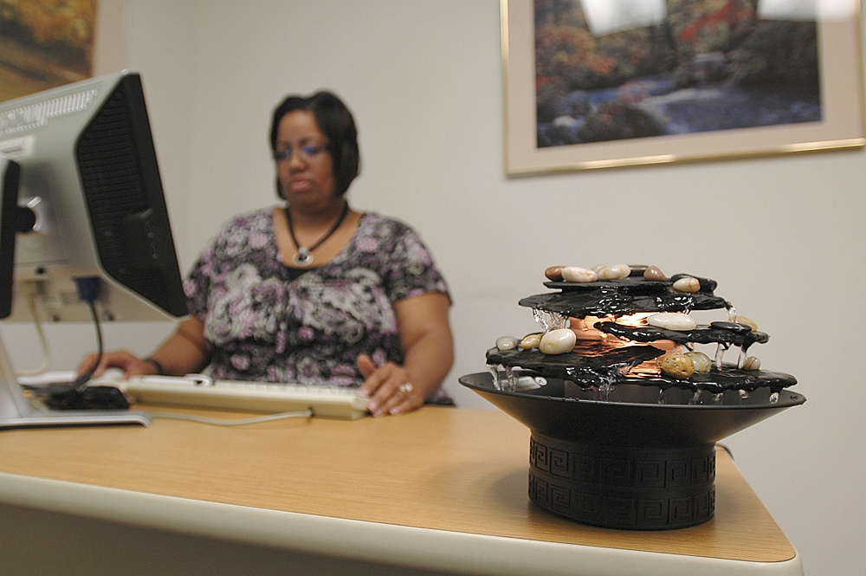
Janet’s Story
Notes:
This slide and the next slide work together as animated slides when in presentation mode. Please look at them in presentation mode before changing or deleting.

Slide 57
Janet’s Story1
Janet keeps a tabletop fountain
running on her desk
The background sound from the fountain makes it easier for her
to focus on her work
This is an example of using background sound
Notes:
In this example, Janet uses background sound making it easier for her to focus on her work

Slide 58

Tell Me in Your Own Words:1
What is the purpose of Background Sound?
Describe the concept rather than giving an example.
HINT:
Notes:
Ask the participant to teach back the purpose of background sound to confirm understanding.
If a participant provides a response that is off-the-mark, first provide further explanation about background sound, then ask them to take another try at describing the purpose of background sound.
The primary purpose of background sound is to fill in the quiet around them to make it easier to do what they want to do (sleep, read, etc.).
Other descriptions for the purpose of background sound could be to supplement the sound environment or add sound so that they are no longer in silence.
Instructions for the session:
This type of sound is sometimes difficult for people to understand. Participants might need further input or explanations.
Please provide further explanation if a participant talks about:
Adjusting the loudness of background sound so that it is as loud or louder than the tinnitus:
Background sound just needs to be present and set to a comfortable level—it should not be set relative to the level of the tinnitus.
Using background sound to cover tinnitus, or to make it quieter:
The purpose of using background sound is not to change the perception of tinnitus in any way.
Using background sound to distract from tinnitus:
The primary purpose of background sound is not to distract from tinnitus (that is the primary purpose of interesting sound) .

Slide 59
Take a Moment to Discuss… 1
Can you think of a background sound that might help you live better with tinnitus?
How might background sound help you do things you want to do?
Environmental sounds, music, or speech
may be background sound for you
Volunteers share your ideas
Notes:
Use this slide with your participants to facilitate discussion.
Instructions for the session:
Use background sound to be able to do daily activity/routine without tinnitus being the focal point.
Encourage them to keep an open mind and try more than one sound including sounds they may not have thought would be helpful as background sound.
If the participants have trouble coming up with ideas, it might help them to think about ideas if you ask:
Which environmental sounds might be a good background sound for you?
Which music might be a good background sound for you?
What speech sounds might be a good background sound for you? ”

Slide 60
Take a Moment to…2
Write down some background sounds that you will try before we meet again
Write down the device you will use
Choose sounds and devices that are easy for you to use
Choose sounds and devices that you already have
Notes:
Give your participants time to fill out the Background Sound section of the Sound Plan Worksheet.
Instructions for the session:
Use background sound to be able to do daily activity/routine without tinnitus being the focal point.
Encourage the participants to try more than one sound.
Encourage them to keep an open mind and to try sounds they may not have thought would be helpful as background sound.
There is an optional worksheet for Background Sound for participants who have difficulty coming up with background sounds to try, or who have aversions to trying sound.

Slide 61

What is Interesting Sound?
Notes:
Orient the participant to the interesting sound section of the worksheet

Slide 62
Interesting Sound
What is it?
    Sound that keeps your attention
    Sound that involves active listening
  How can it help?
    By helping you shift your attention toward something interesting, something you enjoy, something meaningful
  When can it help?
    When you do not need to concentrate on something else
    When you want to relax or sleep
Notes:
Use this slide to explain what interesting sound is, and how and when can it help.
Instructions for the session:
Use of interesting sound is an active listening task. Interesting sound can be used in many situations, but there are considerations when using interesting sound for sleep.
Using interesting sound to fall asleep:
Some people assume that interesting sound shouldn’t be used when people want to relax or sleep. However, it’s important to keep an open mind and make decisions based on experience rather than assumptions about what will happen.
Interesting sound helps many people fall asleep at night and isn’t helpful for others. Experimentation is the only way to know if it will be helpful or not.
People who use interesting sound (e.g. audio books, podcasts) to fall asleep at night say that it helps them get their mind off their tinnitus (and anything else that’s bothering them) long enough to allow them to relax enough to fall asleep. Using interesting sound to help with sleep may be similar to reading a book at night to help with falling asleep.

Slide 63
Interesting Sound: Examples
Environmental Sound
Music
Speech
Whale sounds
Bird calls
Forest sounds
at night
Any environmental sound that is interesting to you
Song lyrics
Various instruments
Live musical
performance
Any music that is
interesting to you
Talking to a friend
Talk radio
Audio book
Podcast
Any speech that is
interesting to you
Any of these could be live or recorded.
Notes:
Walk participants through these examples of interesting sounds. These are examples to get ideas flowing; your participants may use some or none of these.
Remind participants that interesting sound can be recorded or can be live in their environment.

Slide 64
Interesting Sound Activity
Let’s try it!
For this activity, you will hear a brief passage.
Rate your percentage of attention on that passage.
Choose either 0, 25, 50, 75, or 100%
Click
Here
0%
25%
50%
75%
100%
Attention focused on Interesting Sound
Notes:
The intention of this activity is to give the participants some experience of having their attention shifted away from their tinnitus and redirected onto something else.
Use the slide to give participants some experience with paying attention to whether a sound is interesting for them.
If unable to use a sound for this activity, ask participants to share ideas of sounds that they believe will be interesting to them.
The link in the slide is a YouTube video that is 18 minutes long. For demonstration purposes, just play a minute or two of it.
Instructions for the session:
Provider could consider reading a passage or playing a YouTube clip for demonstration purposes. Or asking what sound is interesting to the participants and letting them talk about it.
Ask participants to be ready to share their rating if playing an interesting sound in the session, if participants will be listening to interesting sound outside of the session ask them to be ready to share it at the next session.

Slide 65
Interesting Sound: Things to Think About
The passage you just heard is more interesting
to some people and less interesting to others
Your job is to find sounds that are interesting to you
It might take time and patience to find the sounds
that are most interesting and helpful for you
Sound you find irritating or annoying probably
won’t be helpful
Notes:
Use this slide to emphasize that interesting sound preferences will vary from person to person.
Discuss with the participants that using interesting sound as a distraction from tinnitus is helpful for many.
Instructions for the session:
Ask participants to think about things that really capture their attention.

Slide 66
Sound That is Interesting and Meaningful
Sound that is interesting and has meaning to you might be especially helpful
Let’s discuss:
Adding meaningful sound because you want it in your life versus using sound only to avoid discomfort from tinnitus
Can you think of a sound that is both interesting and meaningful to you?
How might interesting sound help you live better with tinnitus?
Notes:
Sound that is interesting and has meaning to each participant might be especially helpful.
An option is to focus on adding meaningful sound that they want in their life, just because they want it there. For example, sounds that remind them of pleasant memories, music they enjoyed when they were younger, or sound that is connected to their values.
Instructions for the session:
Encourage participants to use interesting sound to bring into their life what they want and care about.
Point out to participants that there’s nothing wrong with using sound for the sole purpose of avoiding discomfort or distress from tinnitus. Anyone who wants that can do that.
Occasionally people will talk about using sound starting to feel like a chore or feel like it’s draining. When that’s the case, it may be especially useful to experiment with adding sound that is meaningful.

Slide 67

Patrick’s Story
Notes:
This slide and the next slide work together as animated slides when in presentation mode. Please look at them in presentation mode before changing or deleting.

Slide 68
Patrick’s Story 2
When Patrick talks to his friend, he is focusing on something that is interesting and meaningful to him: friendship
This is an example of using
interesting sound
Notes:
In this example, Patrick is talking to a friend, which is meaningful for him.

Slide 69
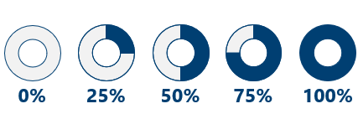
Tell Me in Your Own Words:2
What is the purpose of Interesting Sound? (Describe the concept rather than giving an example)
HINT:
Notes:
Ask participants to teach back the purpose of interesting sound to confirm understanding.

Slide 70
Take a Moment to Discuss…2
Can you think of an interesting sound that might help you live better with tinnitus?
How might interesting sound help you do things you want to do?
Environmental sounds, music, or speech may be interesting to you
Volunteers share your ideas
Notes:
Use this slide with your participants to facilitate discussion.

Slide 71
Take a Moment to…21
Write down some Interesting Sounds that you will try before we meet again
Write down the device you will use
Choose sounds and devices that are easy for you to use
Choose sounds and devices that you already have
Notes:
Give your participants time to fill out the Interesting Sound section of the Sound Plan Worksheet.
There is an optional worksheet for Interesting Sound for participants who have difficulty coming up with interesting sounds to try, or who have aversions to trying sound.

Slide 72
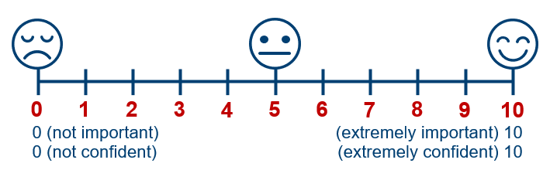
Discussion
How important is it for you to use your sound plan?
How confident are you that you’ll be able to use the
sounds you wrote down before our next meeting?
What might get in the way?
Notes:
Allow time for participants to discuss how important it is for them to use their sound plan, how confident they are that they will use it, and what might get in the way.
Notes for the provider:
When considering a change in life, no matter what it is, we start by asking ourselves two questions: Is it worth it? (importance), and can I do it? (confidence).
Measuring the importance:
Whole Health begins with a focus on each person’s mission, aspiration and purpose, often referred to as MAP.
When we look at health goals, we want to make sure they are connected to each person’s MAP because these are the goals that each person will be most motivated to complete.
Confidence is critical:
Confidence that they can make the change is the second key to success.
If a change means the world to them, yet they are not sure they can achieve it, they might not be successful. Confidence is necessary for the change to be successful.

Slide 73
Whole Health and Tinnitus Plan of Care
Where does using sound fit into your
Whole Health and tinnitus plan of care?
Sounds can fit into
different areas of self-care!
Sound can be used day or
night, even when tinnitus is
not bothering you.
Notes:
Use this slide to encourage discussion about the interplay between using sound and the eight different areas of self care.
Instructions for the session:
Let the participants share an example of how they think sound will fit into their plan of care or you can provide an example.
Sound can be used to facilitate sleep, relaxation, moving the body, personal development, spirit and soul, etc.
Sound can support their whole health and living better with tinnitus goals.
For review of this concept, refer to the module 1 introductory session whole health video.

Slide 74

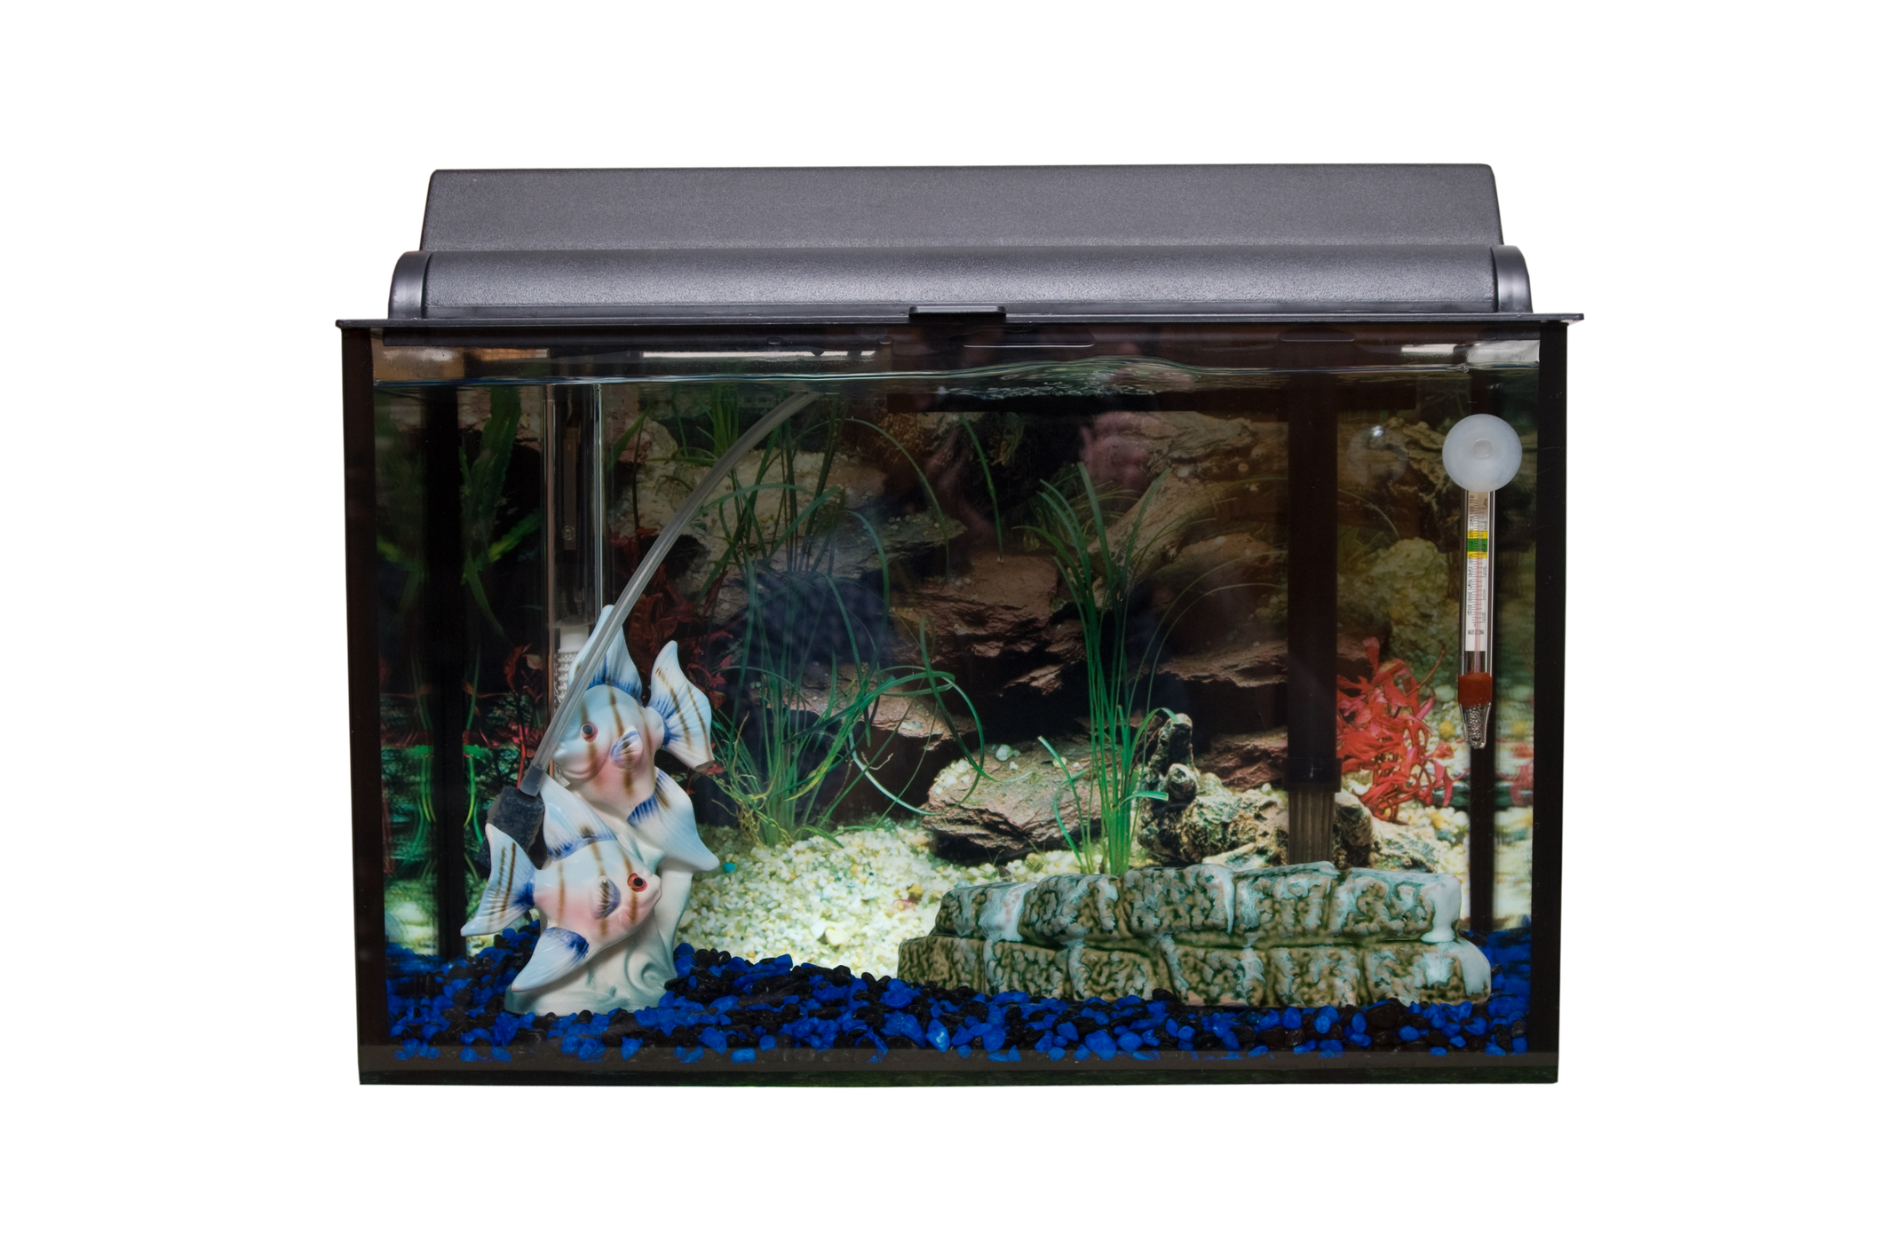
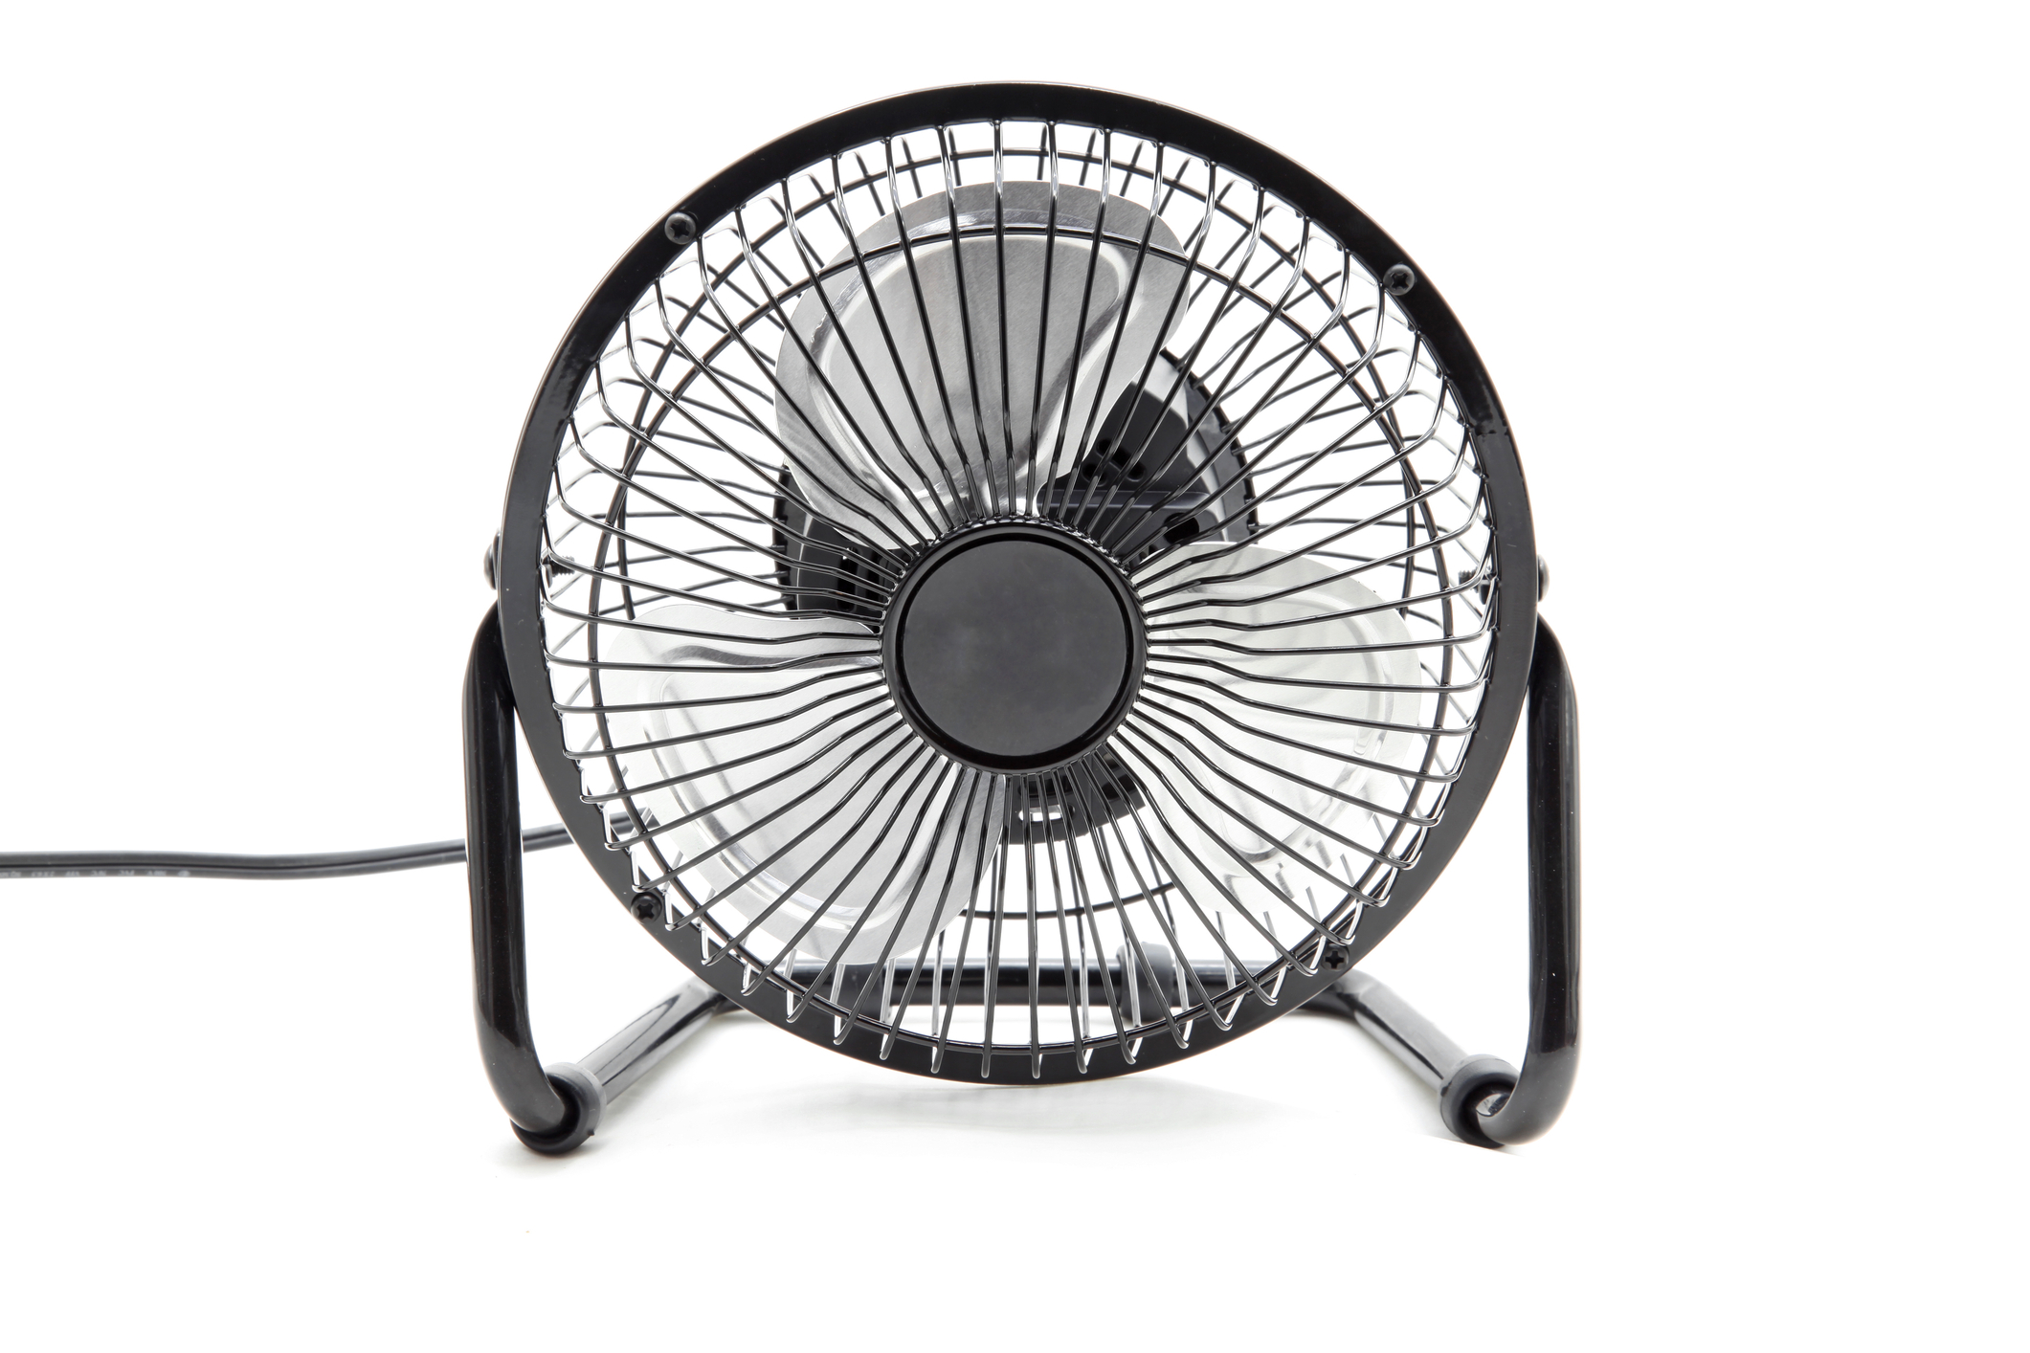
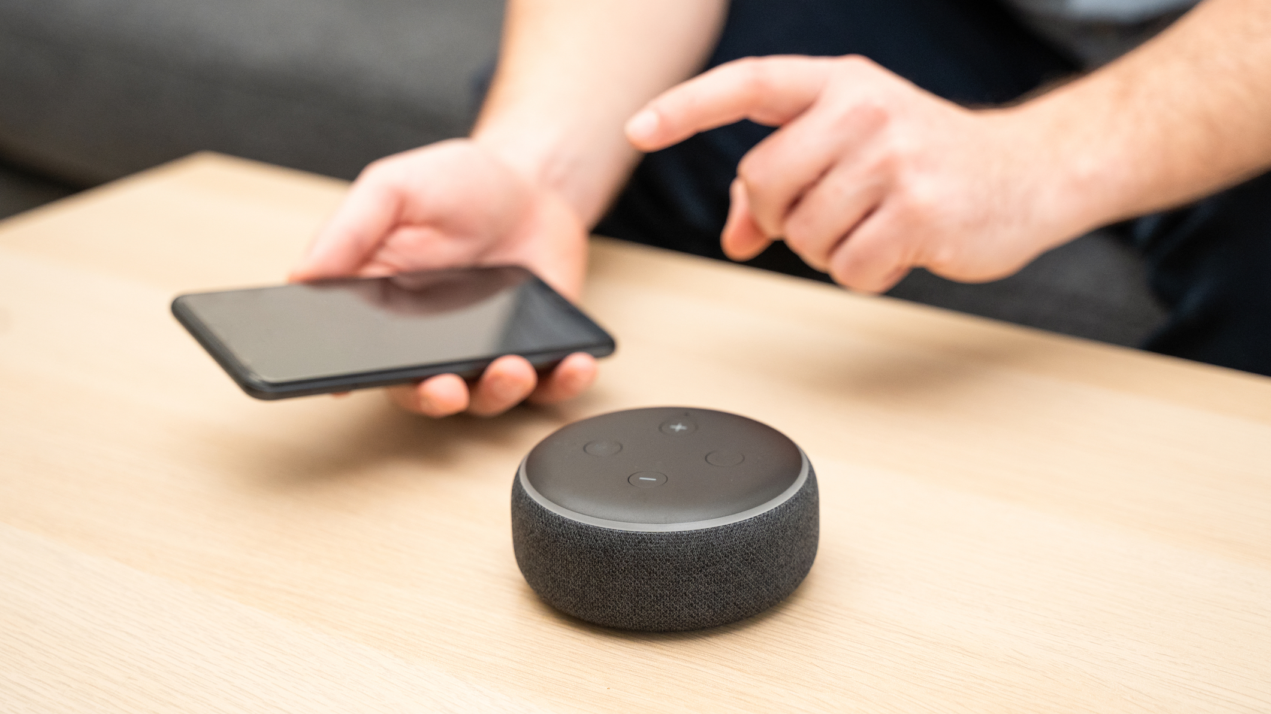
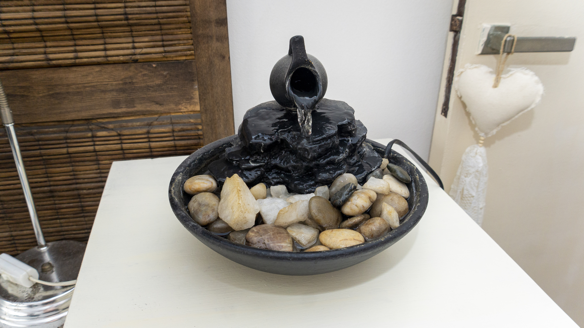
Sound Devices You May Already Have
Notes:
Use this slide to encourage participants to use sound devices they already have.
Instructions for the session:
You may need to update these images over time as technology begins looking outdated.
Fishtank- ID 5032174© Richard Nelson| Dreamstime.com
Fountain- ID 271976716© Christian Lopez Walker| Dreamstime.com
Bluetooth Speaker- ID 167249327© F01photo| Dreamstime.com
Fan- ID 20266060© Vichaya Kiatyingangsulee| Dreamstime.com
Modern Wireless Earbuds - ID 218564013

Slide 75
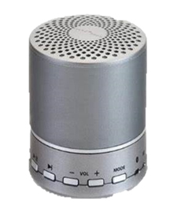
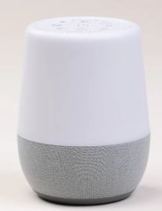
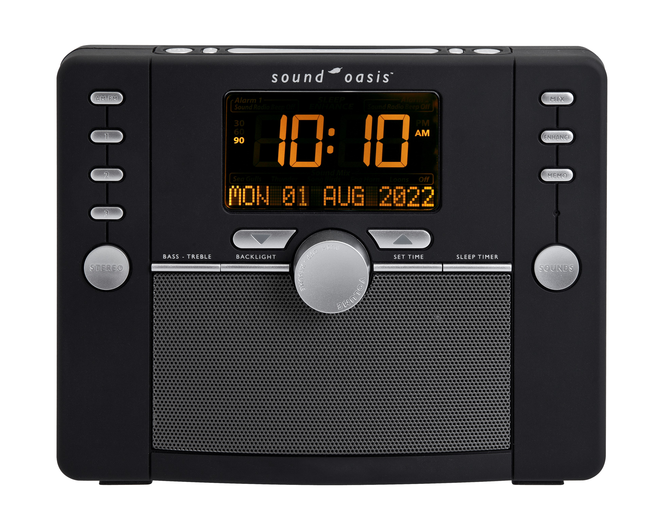
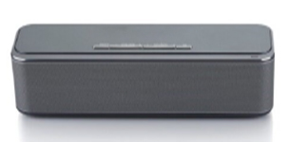
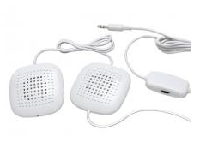
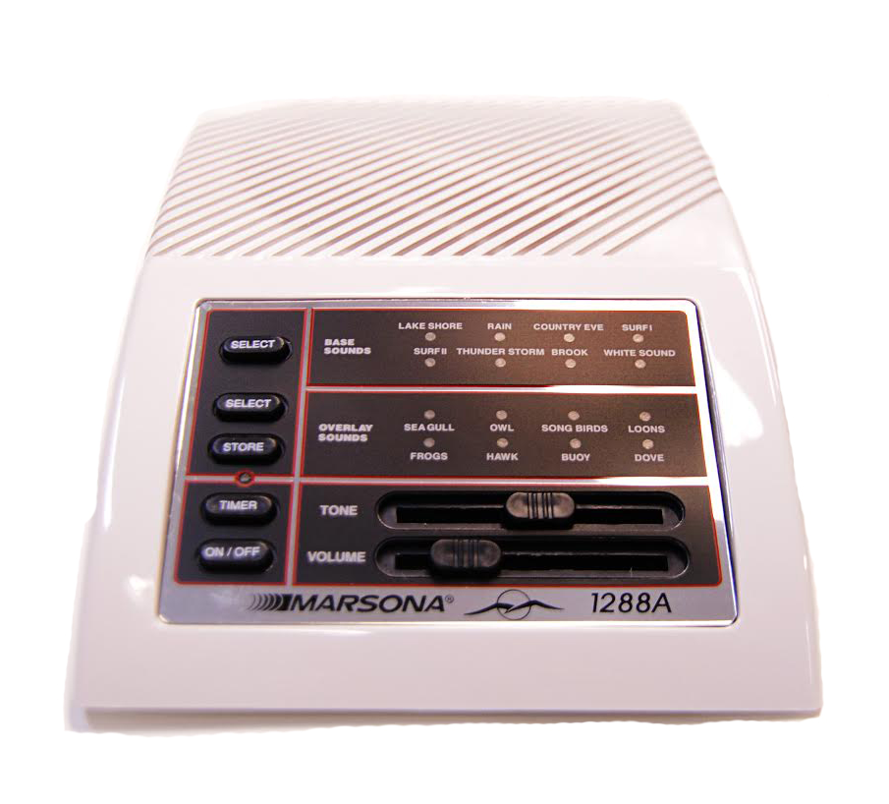
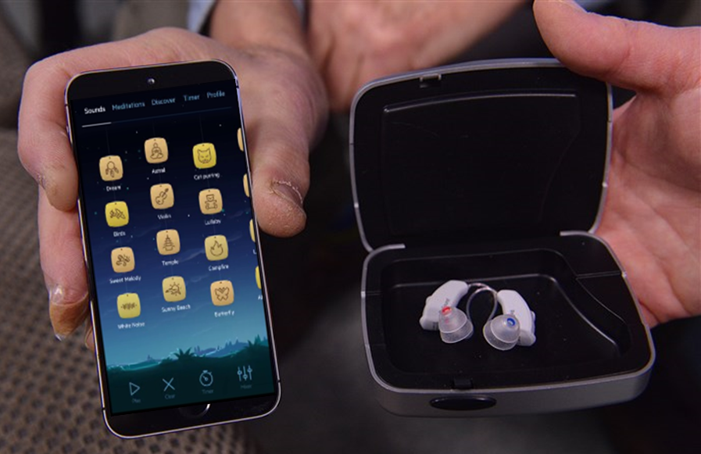

Sound Devices
Notes:
Use this slide to discuss various sound devices. Point out that there are tabletop, portable, hearing aids, and wearable device options.
The devices pictured on this slide were all available to Veterans through the VA at the time the slide was developed. Over time the options will change. This slide will need to be updated as the options change.
Instructions for the session:
Adapt slide to local resources and update as the Prosthetics and ROES devices are added/deleted on contract
Note to the provider:
Mention there are tabletop, portable and wearable devices

Slide 76
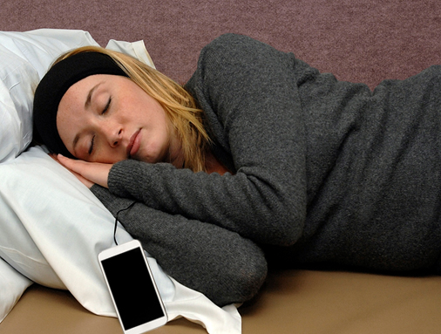
Sharing a bedroom with someone who doesn’t want to hear sound at night?
Sound at Night Options
Devices that may help:
Pillow Speakers
Sound Pillow
Headband with
embedded speakers
Notes:
Pillow speakers, sound pillow and headband with embedded speakers are helpful device options when sharing a bedroom with someone who does not want to hear sound.
You may need to update this slide based on devices available.

Slide 77
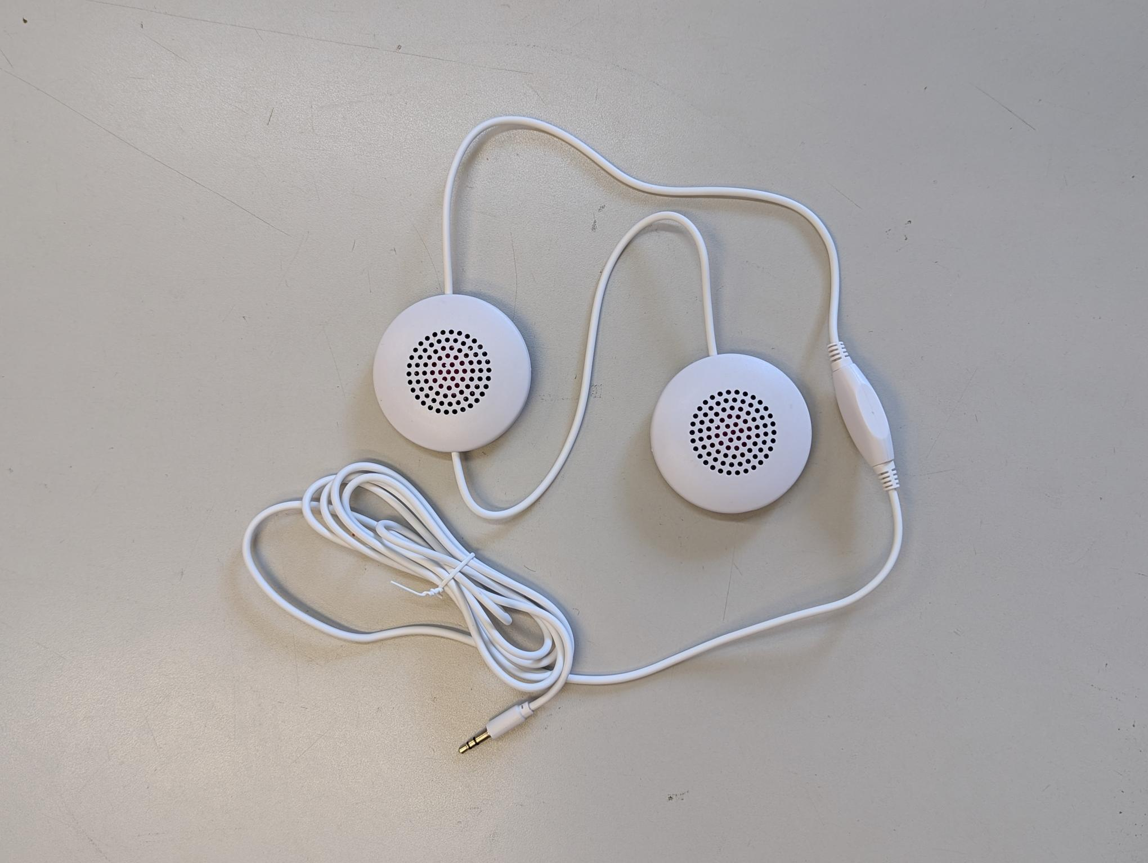
Pillow Speakers
  Slide the speakers into your pillowcase
  A standard sized pillowcase with a pocket is available to hold the speakers in place
  Has a 3.5mm plug that can be plugged into any sound device with a standard headphone jack
Disadvantage: sound is usually only heard in one ear when sleeping on your side
Notes:
The pillow speaker can be plugged into anything with a standard headphone jack.
These are a good choice for participants who want to continue using their own pillow.
A disadvantage is that sound is usually only heard in one ear when sleeping on your side.
Helpful hint: some people put one speaker in the pillow and attach the other speaker to the headboard to have sound in both ears (Velcro or other adhesives).

Slide 78

Sound Pillow
    Two high fidelity, ultra-thin stereo speakers positioned deep within the pillow
    It has a 3.5mm connector that can be plugged into any sound device with a standard headphone jack
    Bluetooth option available
    Disadvantage: sound is usually only heard in one ear when sleeping on your side
Notes:
The sound pillow can be plugged into anything with a standard headphone jack. A disadvantage is that sound is usually only heard in one ear when sleeping on your side. A Bluetooth option is available.

Slide 79
Headband with Embedded Speakers
Wired or wireless option available
  Wired option plugs into any device with standard headphone jack
  Wireless option pairs with Bluetooth-capable devices
Only you hear the sound
  Sound is heard in both ears
  Some don’t like the extra warmth when sleeping
Notes:
There are wired and wireless options to connect the headband with the advantage that sound is heard in both ears while sleeping.

Slide 80
How to Get These Devices?
Talk to your audiologist about receiving these sound devices
Notes:
Explain to the participants how to receive sound devices from your site.

Slide 81
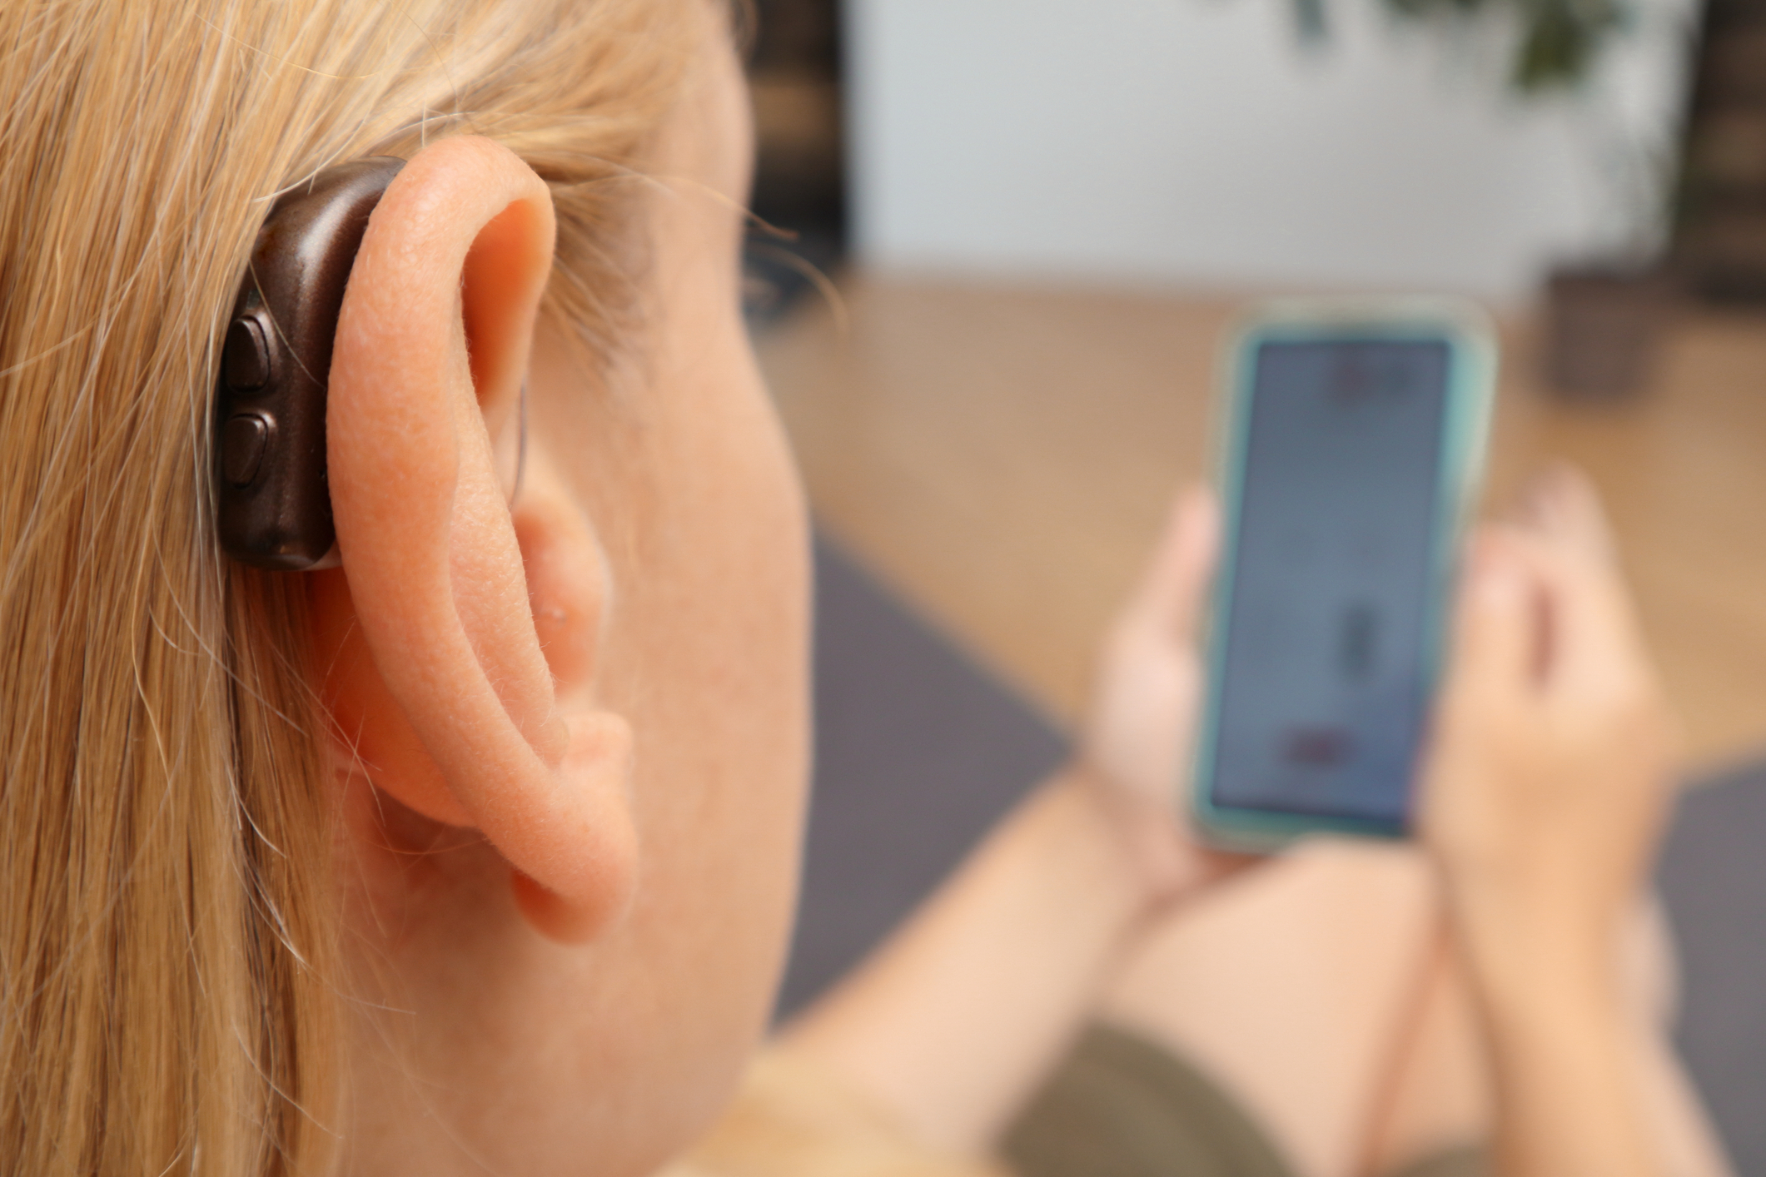
Mobile Devices and Apps
Do you have a mobile device?
Are your hearing aids paired to your mobile device?
  If you need help getting your hearing aids connected to your mobile device, ask for a consumer tech support contact number
Streaming services and mobile apps you are already using to listen to music, podcasts, audiobooks, etc., may be routed through your hearing aids
Look at mobile.va.gov for self-care mobile apps
Notes:
Streaming services and mobile apps you are already using to listen to music, podcasts, audiobooks may be routed through your hearing aids. In addition, there are many free self care mobile apps available at mobile.va.gov
Instructions for the session:
Have a handout with Veteran consumer tech support, or customer assistant lines for each hearing aid manufacturer. This might be a cards, stickers, or a sheet of paper with a list of appropriate contact information for Veterans to use to access support in connecting their hearing aids to their smart phone.

Slide 82
Annie App Tinnitus Messages Are Available
Annie app is an optional text message reminder that sends automated messages to help you stay focused on your tinnitus plan of care
Text messages are monitored by the health care provider
Messages are not secure and there could be costs depending on your data plan
Sending “Start” and “Stop” begins and ends participation in the program
If you are interested in receiving text reminders, please let me know and I will register you
Using Annie is voluntary
Notes:
Annie is a VA service that sends automated text messages to Veterans to help them stay focused on their self-care.
Discuss with participants that Annie app is an optional text message reminder about their tinnitus plan of care.
At the time of the module’s release, information about Annie app was located here ANNIE - Annie (sharepoint.com) Annie for Clinicians | VA Mobile and includes training materials and other resources for clinicians and Veterans.
Annie tinnitus specific messages provide supportive text messages to help Veterans continue to develop and sustain their living better with tinnitus skillset.
Participation is voluntary
Annie tinnitus messages automatically are sent out for 12 months and will cease automatically after 12 months.
Veterans can opt out at any time by texting “Stop” to the messages.
Clinicians can choose nationally created messages or create their own at the local level with their facility’s connected care service.
The nationally created messages include prompts to return outcomes. These can be turned off or deleted when you add the patient.
Annie app provider-activated messages apply to the clinical tools used in the PTM 2.0 Living Better with Tinnitus Workshops and are specific to the worksheets used in these workshops. However, be aware that there are general tinnitus messages that Veterans can activate through the Annie app for Veterans. These messages are different than the educational messages for those participating in the workshops which are provider-prescribed. Veterans cannot activate the PTM-specific messages themselves; they must be activated by a provider through the Annie app for clinicians. Providers should only activate the PTM-specific messages for Veterans who want them to be activated. Veterans may activate general tinnitus messages from the Annie app by themselves, but they will not contain any PTM-specific content.
Check with your local facility regarding documentation requirements for Annie messages. An Annie note template may be available in some locations. Providers are encouraged to document that the Veteran consented to receive messages through Annie app -- in some cases text messaging charges may be incurred by Veterans based on their data plan.

Slide 83
Next Session
Be prepared to talk about your progress using your sound plan
Next session will be Living Better With Tinnitus: Pleasant Activities
Notes:
Frequency of sessions may vary depending on availability of providers.
Edit this slide for what your next session is going to be.
Share with participants the topic for the next session and be prepared to discuss their sound plan outcomes.

Slide 84
Tinnitus Resources
NCRAR: https://www.ncrar.research.va.gov/ClinicianResources/index.asp
DOD Veterans website for Tinnitus: https://www.hearing.health.mil/Education/Tinnitus
National Institute on Deafness and Other Communication Disorders: https://www.nidcd.nih.gov
Ida Institute: https://idainstitute.com/tools/tinnitus/
VA Mobile Apps: https://mobile.va.gov
Whole Health Resources for Veterans: https://www.va.gov/wholehealth
Breathing, Meditation, Mindful Movement, & Guided Rest: https://www.veteransyogaproject.org/practice
National Institutes of Health (NIH): https://clinicaltrials.gov
MyHealtheVet (MHV): https://www.myhealth.va.gov Help Desk at 1-877-327-0022
VA Office of Connected Care: https://www.connectedcare.va.gov Help Desk 1-866-651-3180
Notes:
These are some suggested resources to share. These resources are also located in the resource handout of this course.
You may have locally approved resources from your patient education committee that you may want share.

Slide 85

THANK YOU
FOR YOUR
SERVICE
Notes:
Thank Veterans for their service.

Slide 86
Bonus Content: Optional
Some participants may need practice with a particular type of sound or all three types of sound before moving onto the Sound Plan Worksheet.
  When that is the case, you may consider using the optional sound worksheets embedded at the bottom of this slide.
  They contain step-by-step instructions for experimenting with sound.
  These worksheets/activities may also be useful with participants who have sound tolerance issues or prefer to be in silence and therefore need a slower and more controlled exploration of sound before moving onto the Sound Plan Worksheet.

